Slide 1
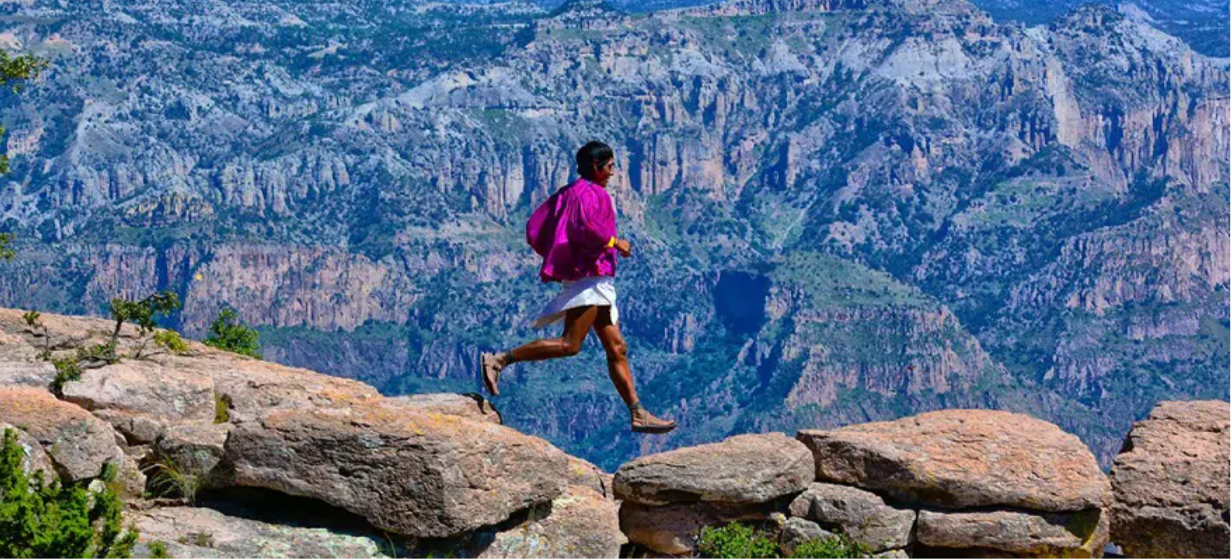
Bridging Generational Knowledge: Digital Storytelling in The Raramuri Community
Rafa Gonzalez
PhD Candidate
University of Kansas
04/13/2024

Slide 2
Overview
Focus: Empowering Rarámuri identity through digital storytelling in Chihuahua.
Approach: Collaborative workshops rooted in community participation and ethical engagement.
Goal: Strengthen cultural ties and foster place-making within the Rarámuri community.

Slide 3
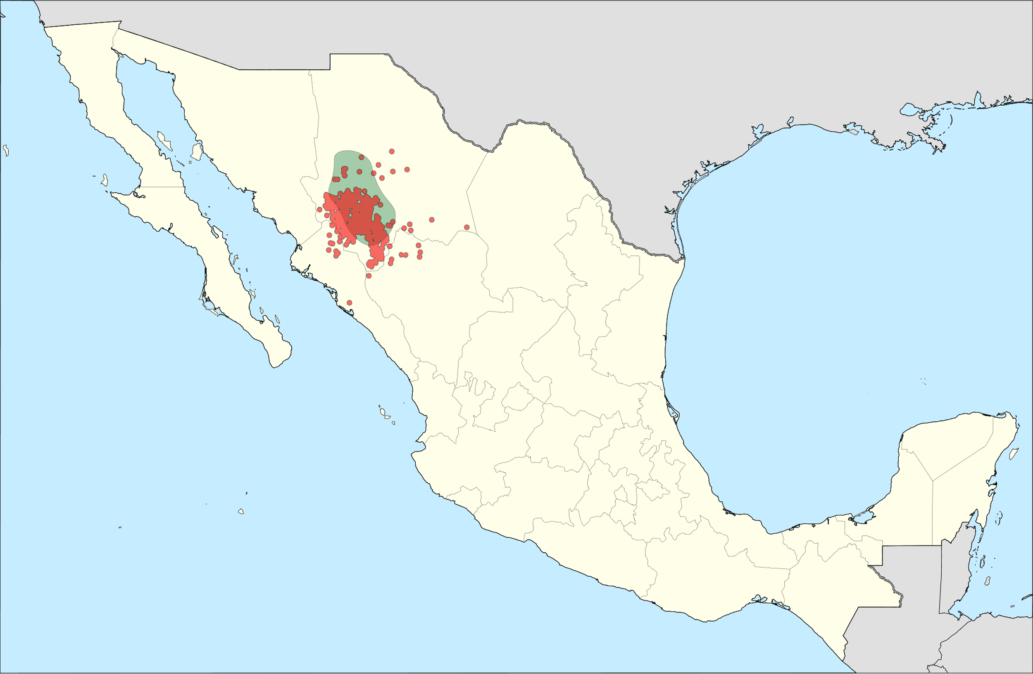

Slide 4
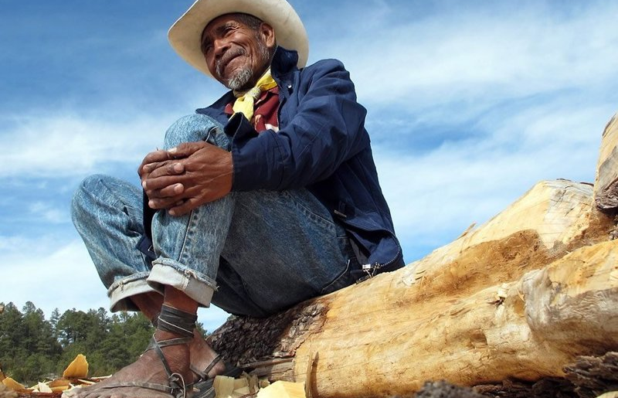
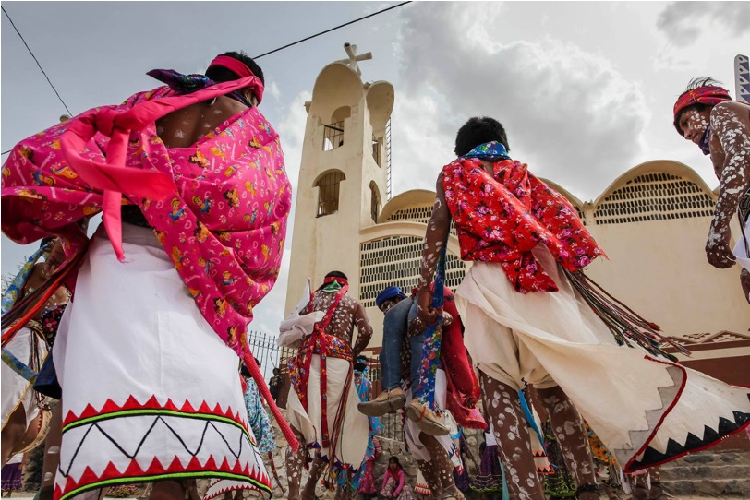
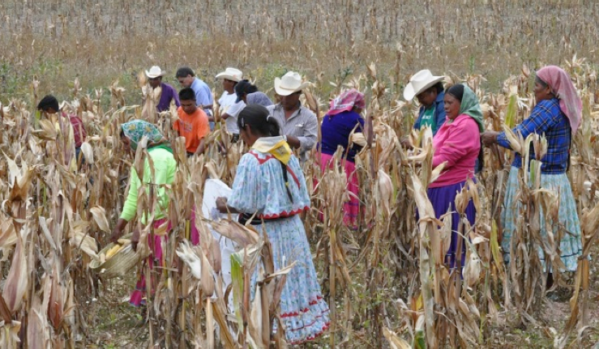

Slide 5
“The Rarámuri people ran away to save themselves from the colonizers to save our nation, our culture. They didn't want to be disappeared like many of the other indigenous nations that existed in Chihuahua. They retreated to several remote areas of the mountains, where they could hide. A wise man said that if we all live in the same place, and someone wants to harm us, meaning the 'mestizo' culture, we'd all die together. And then who would be left to carry on our culture?”
-Irma Chavez

Slide 6
The Raramuri in the City
Urban Settlements Overview
Diverse Communities: Over 8 settlements within Chihuahua City, housing Rarámuri families.
Population Insight: Approximately 5,000 Rarámuri residents across all settlements.
Focus on Carlos Arroyo Settlement
Community Scale: Home to around 300 Rarámuri, established in 2006 and is one of the new settlements
Origins of Settlements
Established by Aid: A result of initiatives by NGOs, religious organizations, and state efforts.
Purpose: Aimed to provide housing and integrate Rarámuri into urban settings, while also facing challenges of integration and discrimination

Slide 7
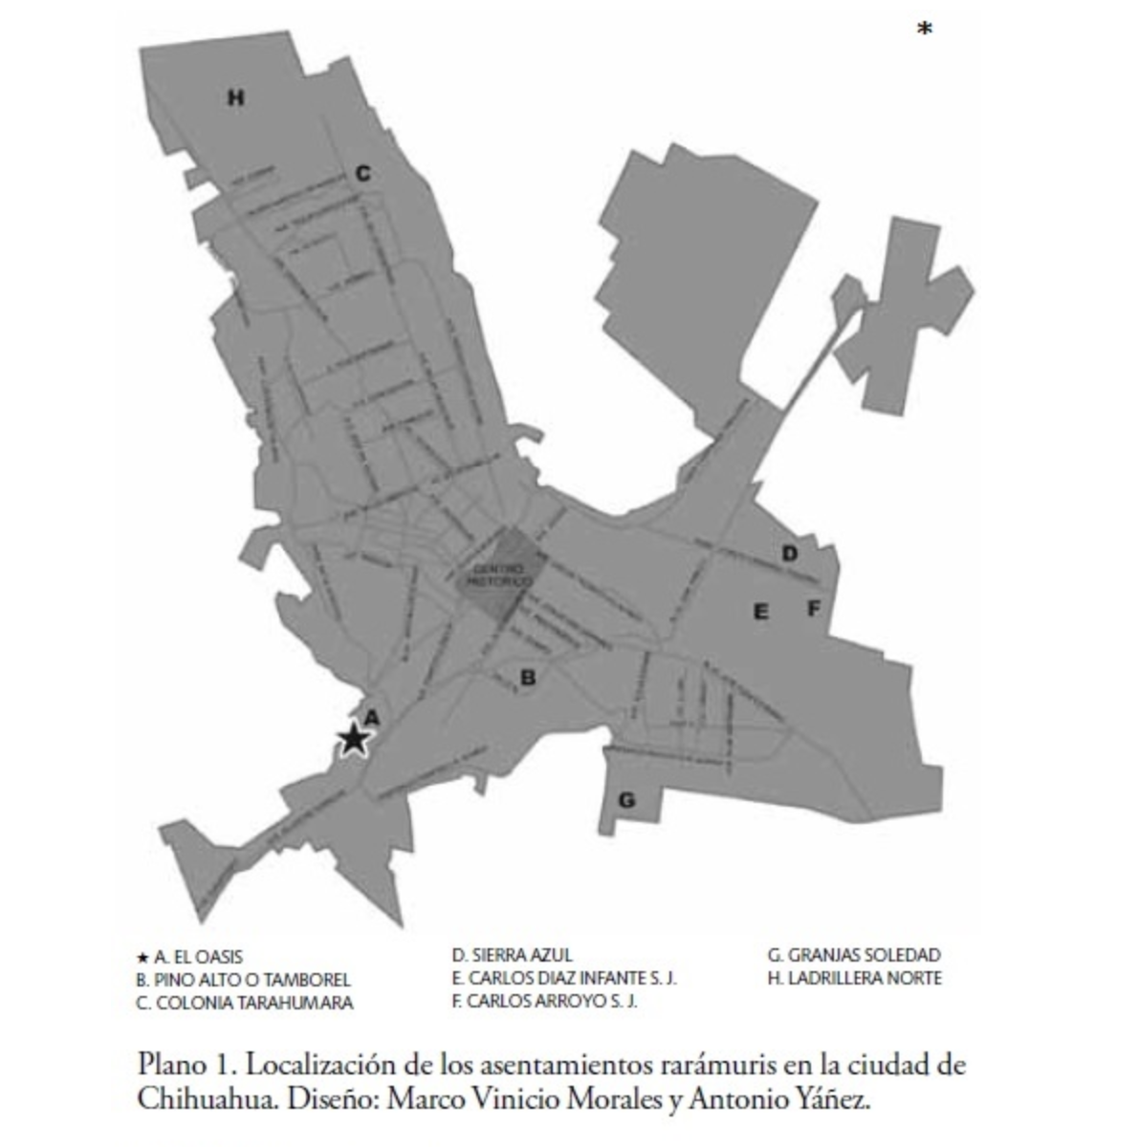
Settlement Map

Slide 8
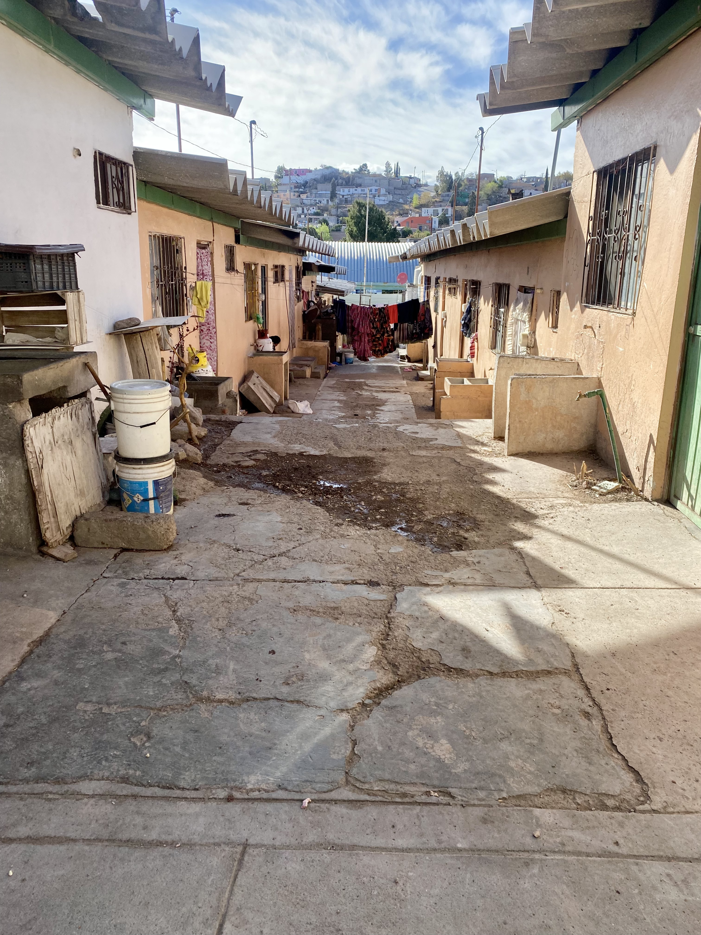
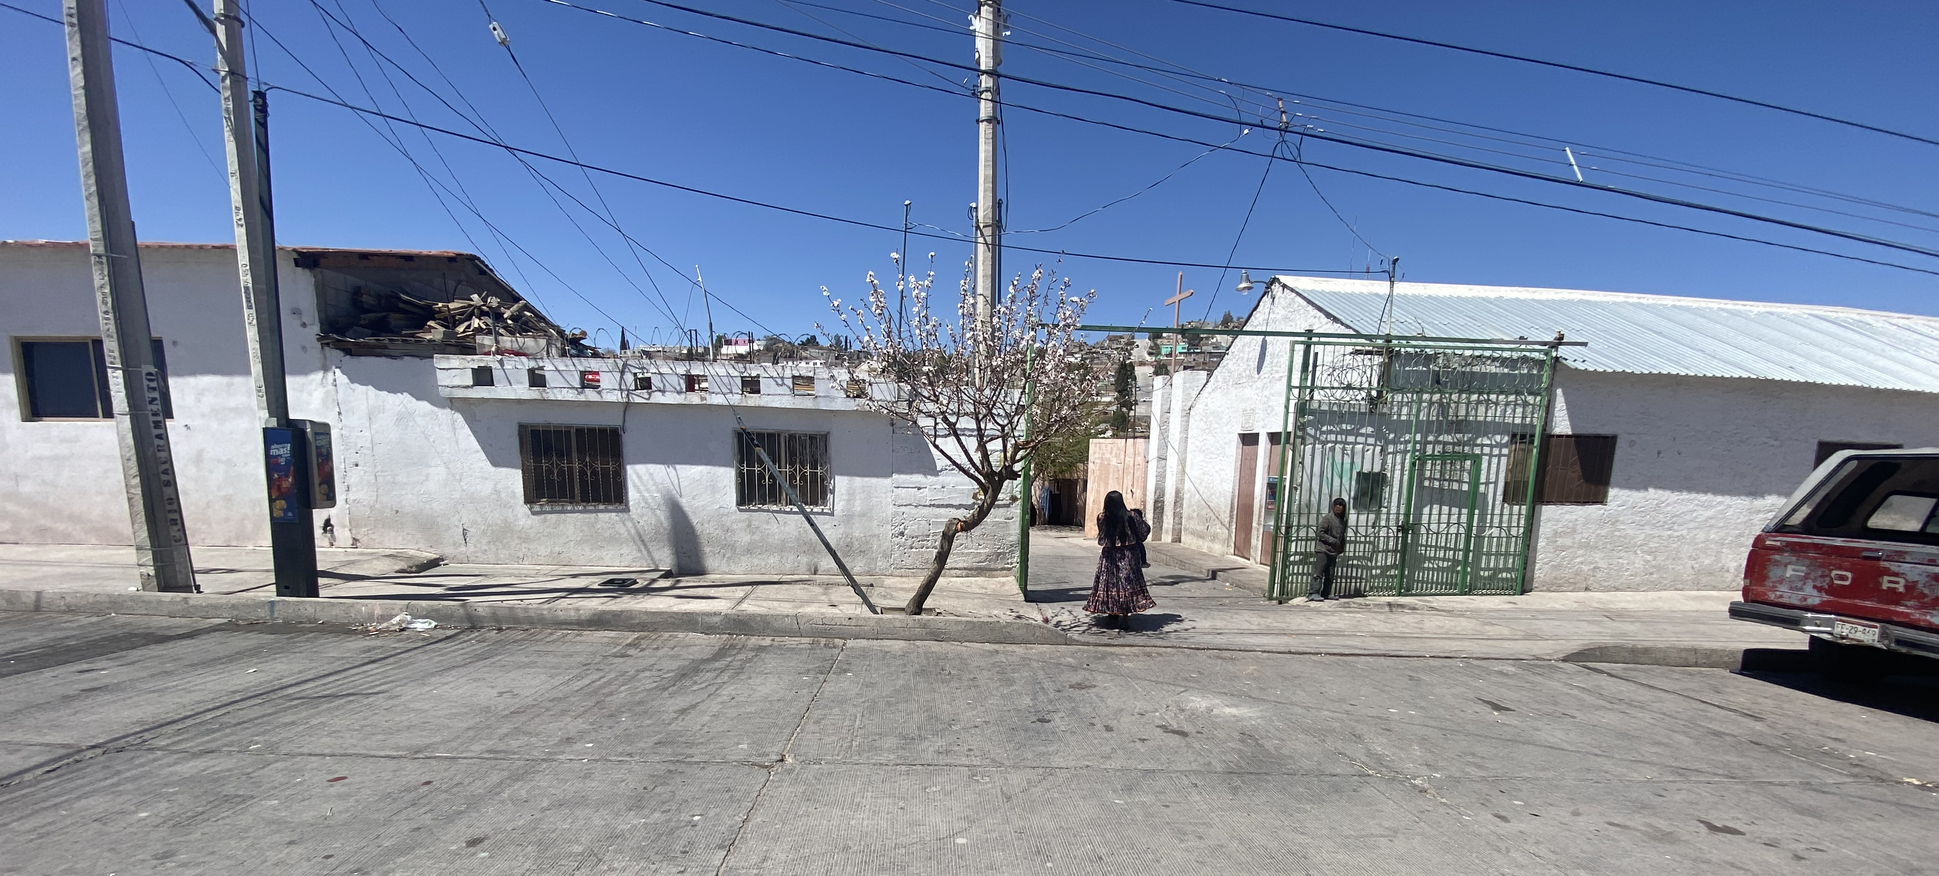
Oasis Settlement

Slide 9
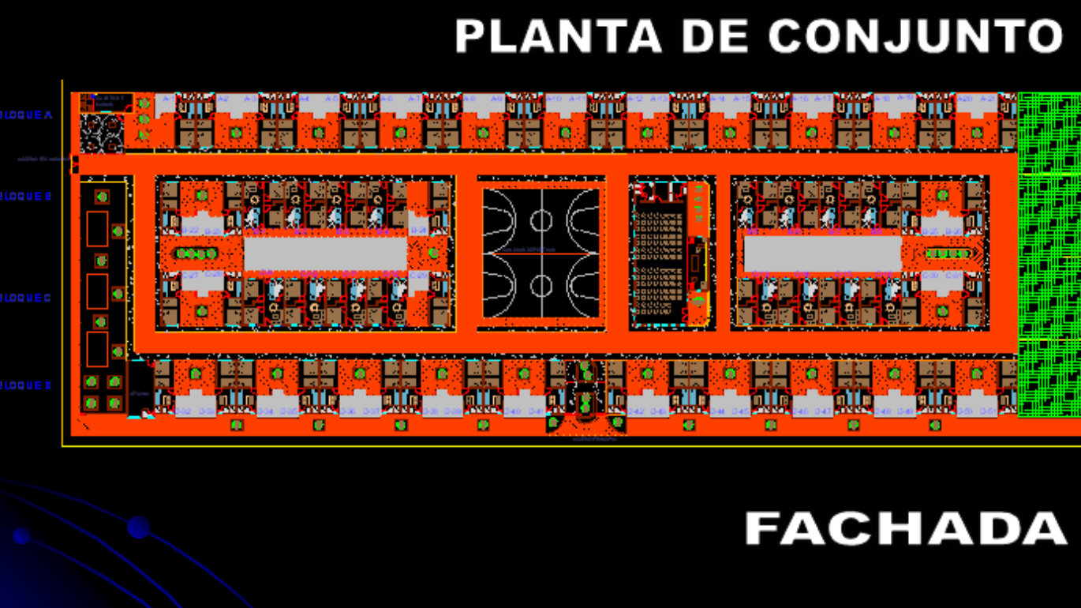

Slide 10
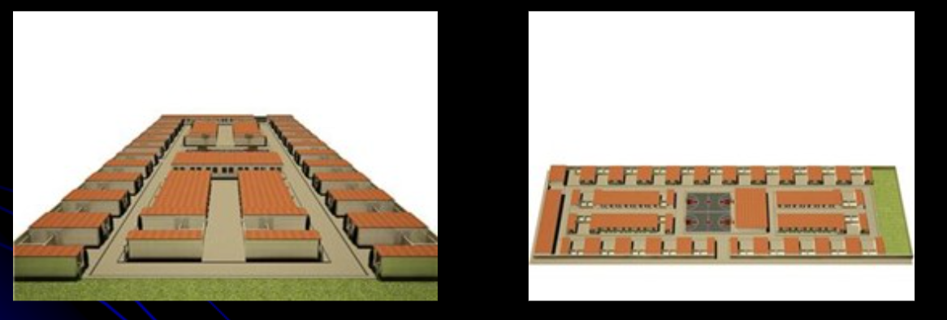

Slide 11
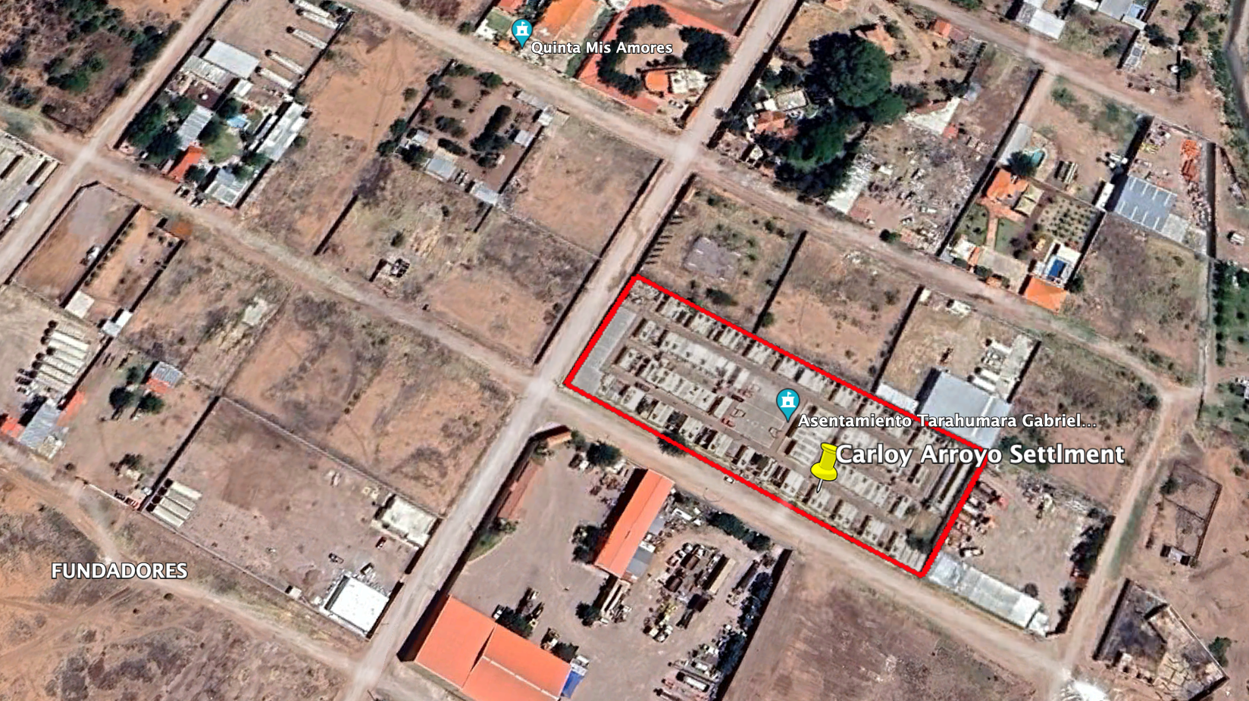

Slide 12
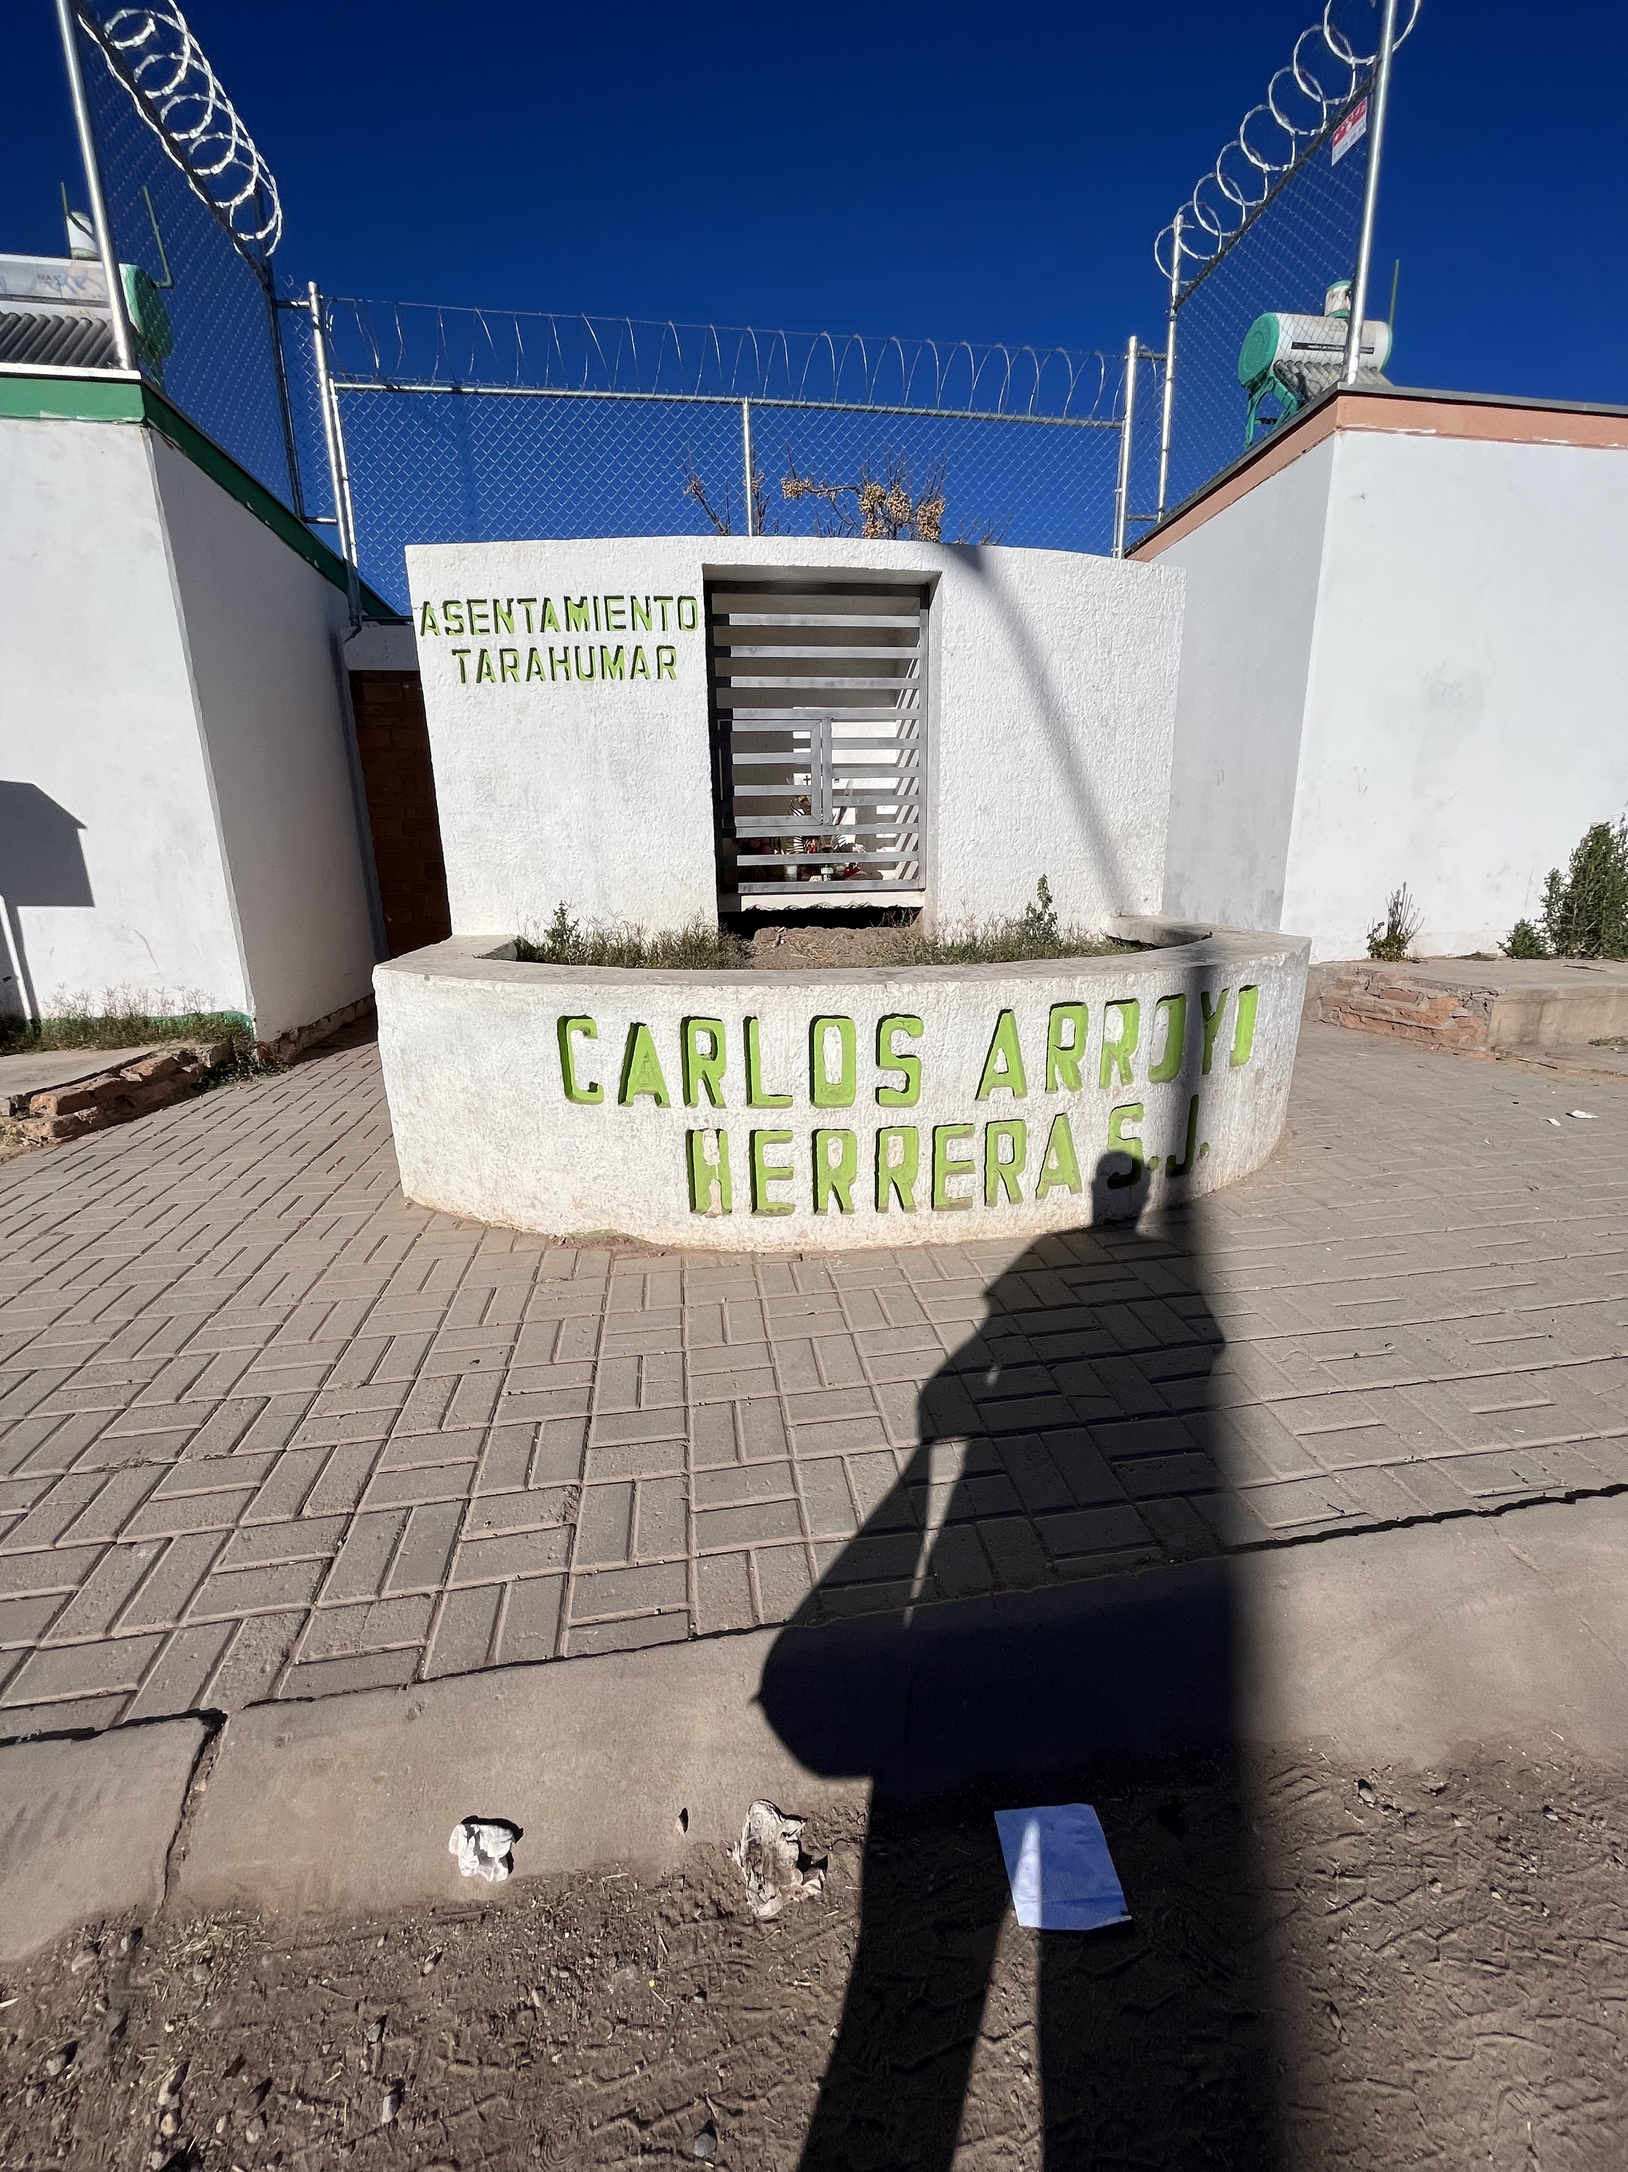
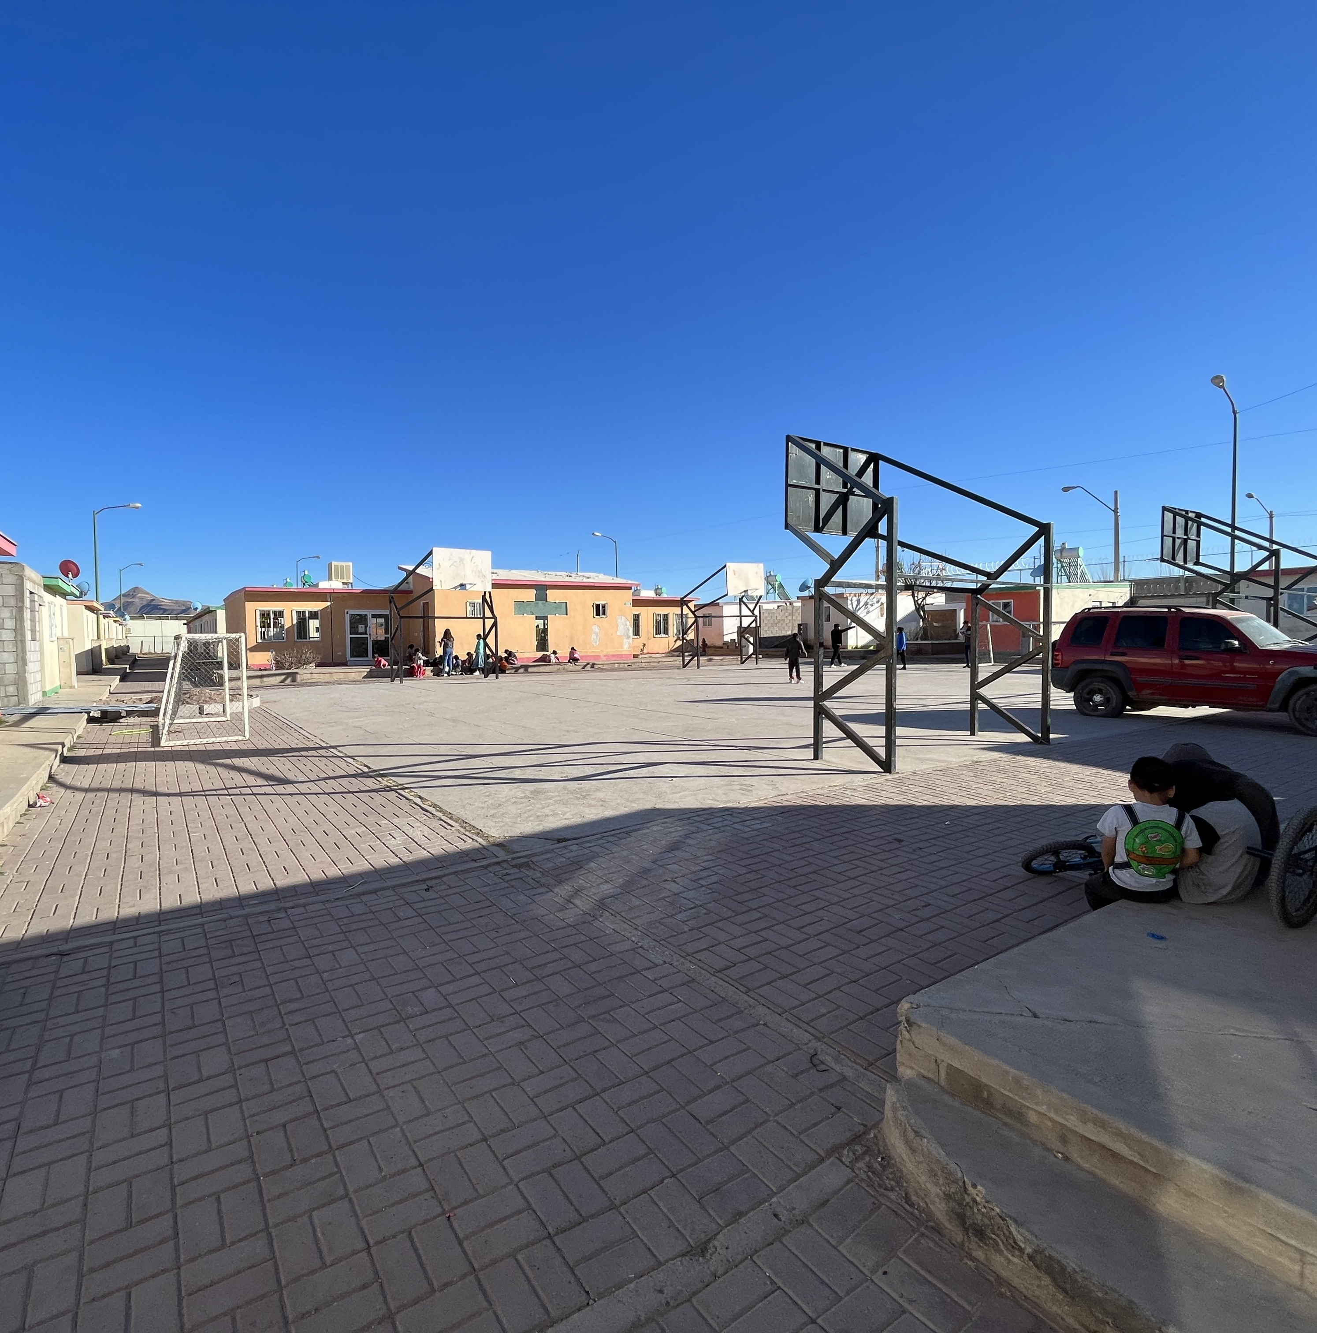

Slide 14
Research Objectives & Questions
Main objectives: To facilitate intergenerational knowledge transfer and reinforce community bonds using digital storytelling
What are the modalities for knowledge transfer between the Rarámuri elders and the youth in an urban setting?
How do digital storytelling initiatives influence the relationships and community bonds between the Rarámuri elders and youth?

Slide 15
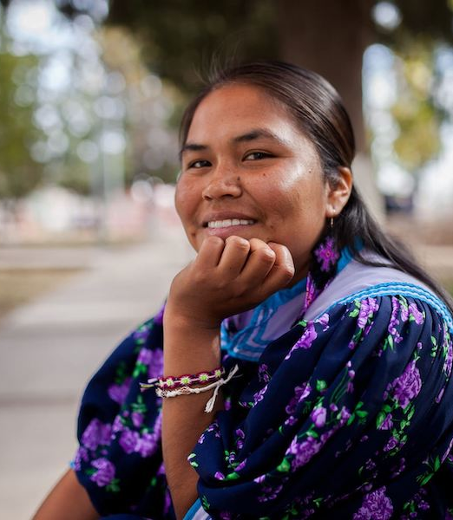
Ethical Research Practices with the Rarámuri
Permission
Community-Led Content
Technology Piloting:
Collaboration and Ethical Engagement:
Sustaining Relationships

Slide 16
Methodology Overview:
Participant Observation: Deep engagement within the Carlos Arroyo settlement to document daily life and cultural exchanges.
Pilot Testing: Assessing the suitability of digital tools like cameras and editing software in collaboration with community members.
Digital Storytelling Workshops: Facilitating a multi-stage workshop process from introducing digital tools to producing complete stories. Modeled after Hausknecht (2021)
Semi-Structured Interviews: Conducting tailored interviews to gather detailed insights into the community's experiences with digital storytelling.

Slide 17
Introduction to Digital Narratives
Oral Knowledge Exchange
Crafting and Creating Digital Stories
Celebrating Shared Stories and Community Empowerment
Multi-Stage Workshops

Slide 18
Introduction and Trust-Building
Interactions: Introductions among elders, youth, and facilitators to foster community ties.
Trust: Establishing a collaborative atmosphere for shared learning and storytelling.
Digital Storytelling Unveiled
Exploration: Demonstrating storytelling tools tailored for youth.
Engagement: Discussing community's key stories and knowledge to preserve digitally.

Slide 19
Sharing Oral Knowledge
Honoring Elders’ Narratives
Wisdom Sharing: Elders recounting stories and knowledge in Rarámuri or Spanish.
Cultural Resonance: Emphasizing the significance of oral traditions in cultural heritage.
Inclusive Storytelling
Collaborative Recording: Youth capturing elders' tales through audio recording.
Accessibility: Translating stories to maintain authenticity for all community members.

Slide 20
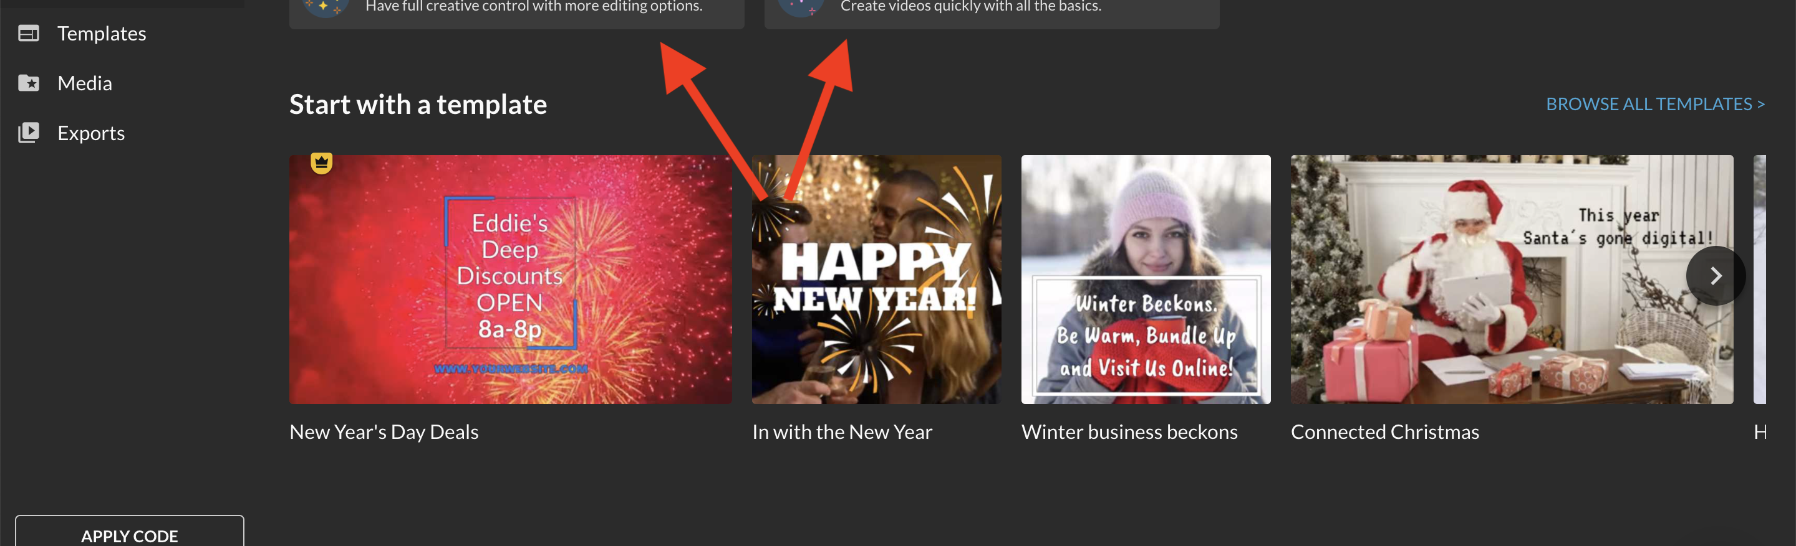
Crafting and Creating Digital Stories
Shaping Narratives
Creative Process: Transforming oral histories into storyboards and scripts.
Hands-On Learning: Training in capturing images and videos with accessible technology.
Digital Story Production
Storytelling Tools: Utilizing user-friendly WeVideo for editing.
Ownership: Ensuring stories crafted are personal and community-driven.

Slide 21
Celebrating Shared Stories
Premiering Digital Stories
Showcase Event: Community gathering to view and celebrate the completed digital stories.
Cultural Reflection: Acknowledging the role of storytelling in reinforcing identity and history.
Empowering the Storytellers
Ownership: Affirming the community’s control over their digital narratives.
Legacy: Encouraging the continued practice of story-sharing as a vital cultural pillar.

Slide 22
Future Direction
Participatory observation and pilot testing technology in Summer 2024
Runing the workshops
Project expansion into other settlements
Strengthen Raramuri cultural identity and intergenerational ties
Model for preserving Indigenous knowledge

Slide 23
References:
Hausknecht, Simone; Freeman, Shannon, Jenny Martin, Carrie Nash & Kelly Skinner (2021) Sharing Indigenous Knowledge through intergenerational digital storytelling: Design of a workshop engaging Elders and youth, Educational Gerontology, 47:7, 285-296, DOI: 10.1080/03601277.2021.1927484
Marco Vinicio Morales Muñoz, "Introduction," in QUALIFICATION: Rarámuri Gender and Ethnicity in the City of Chihuahua (Mexico City: National Institute of Anthropology and History, 2020)
Ramos, Martha. "Migración de Tarahumaras hacia la Ciudad de Chihuahua, México." Tesis de Licenciatura en Antropología Social, Universidad Iberoamericana, 1997.
Ryan, Anne Wally, and Jørund Aasetre. "Digital Storytelling, Student Engagement and Deep Learning in Geography." Journal of Geography in Higher Education 45, no. 3 (2021): 380-96.
Smith, L. T. (2021). Decolonizing Methodologies: Research and indigenous peoples. Zed Books Ltd.
Latulippe, N., Livesey, B., Whaanga-Schollum, D., Jamieson, C., Clark, J., & Kiddle, R. (Becky). (2023). Maanjiwe Nendamowinan (The Gathering of Minds): Connecting Indigenous placemakers and caring for place through co-creative research with the Toronto Islands. Environment and Planning F, 2(1-2), 96-120. https://doi.org/10.1177/26349825231163152

Slide 24
Q&A

