Slide 1
Cosmic Collisions: Exploring Galaxy Mergers Through JWST
Greg Troiani
University of Kansas
Dr. Allison Kirkpatrick
PALOOZA, 4/13/2024

Slide 2
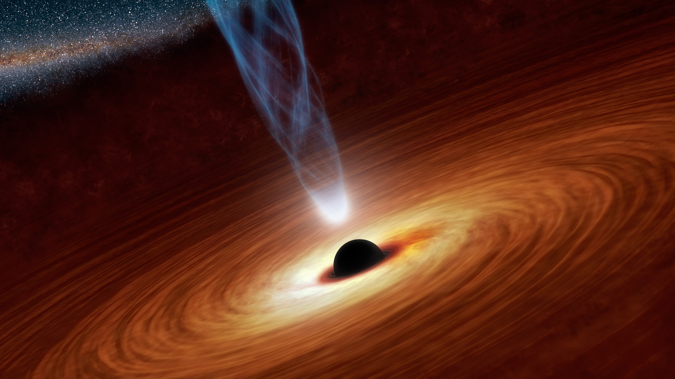
Background: Accretion histories
Most galaxies host a supermassive black hole (SMBH)
SMBHs in early universe are larger than can be explained from accretion from stellar seeds
Black hole growth occurs early
A lot of expected middle and high-z BH growth is missing (Volonteri et al 2017, Kirkpatrick et al 2023)
Black hole growth isn’t continuous
How and when did BH growth occur?
https://upload.wikimedia.org/wikipedia/commons/f/f0/Black_Holes_-_Monsters_in_Space.jpg

Slide 3
Background: Mergers and selection bias
Proposed solution: Active Galactic Nuclei (AGN) are triggered through mergers (Hopkins 2008)
Angular momentum loss ➔ material falling onto BH
Reproduces bulge-BH relation, quasar populations
Importance of mergers subject of debate
Kocevski et al. 2012: No connection b/w active galaxies and mergers
72 x-ray selected AGN at intermediate redshift
Gao et al 2020: AGN preferentially reside in merging galaxies
Large sample of low-redshift galaxies
These observations made with Spitzer or WFC3 aboard Hubble, or ground-based observations
INCOMPLETE DATA
Are these missing AGN at low luminosities?
Are they triggered by mergers?

Slide 4
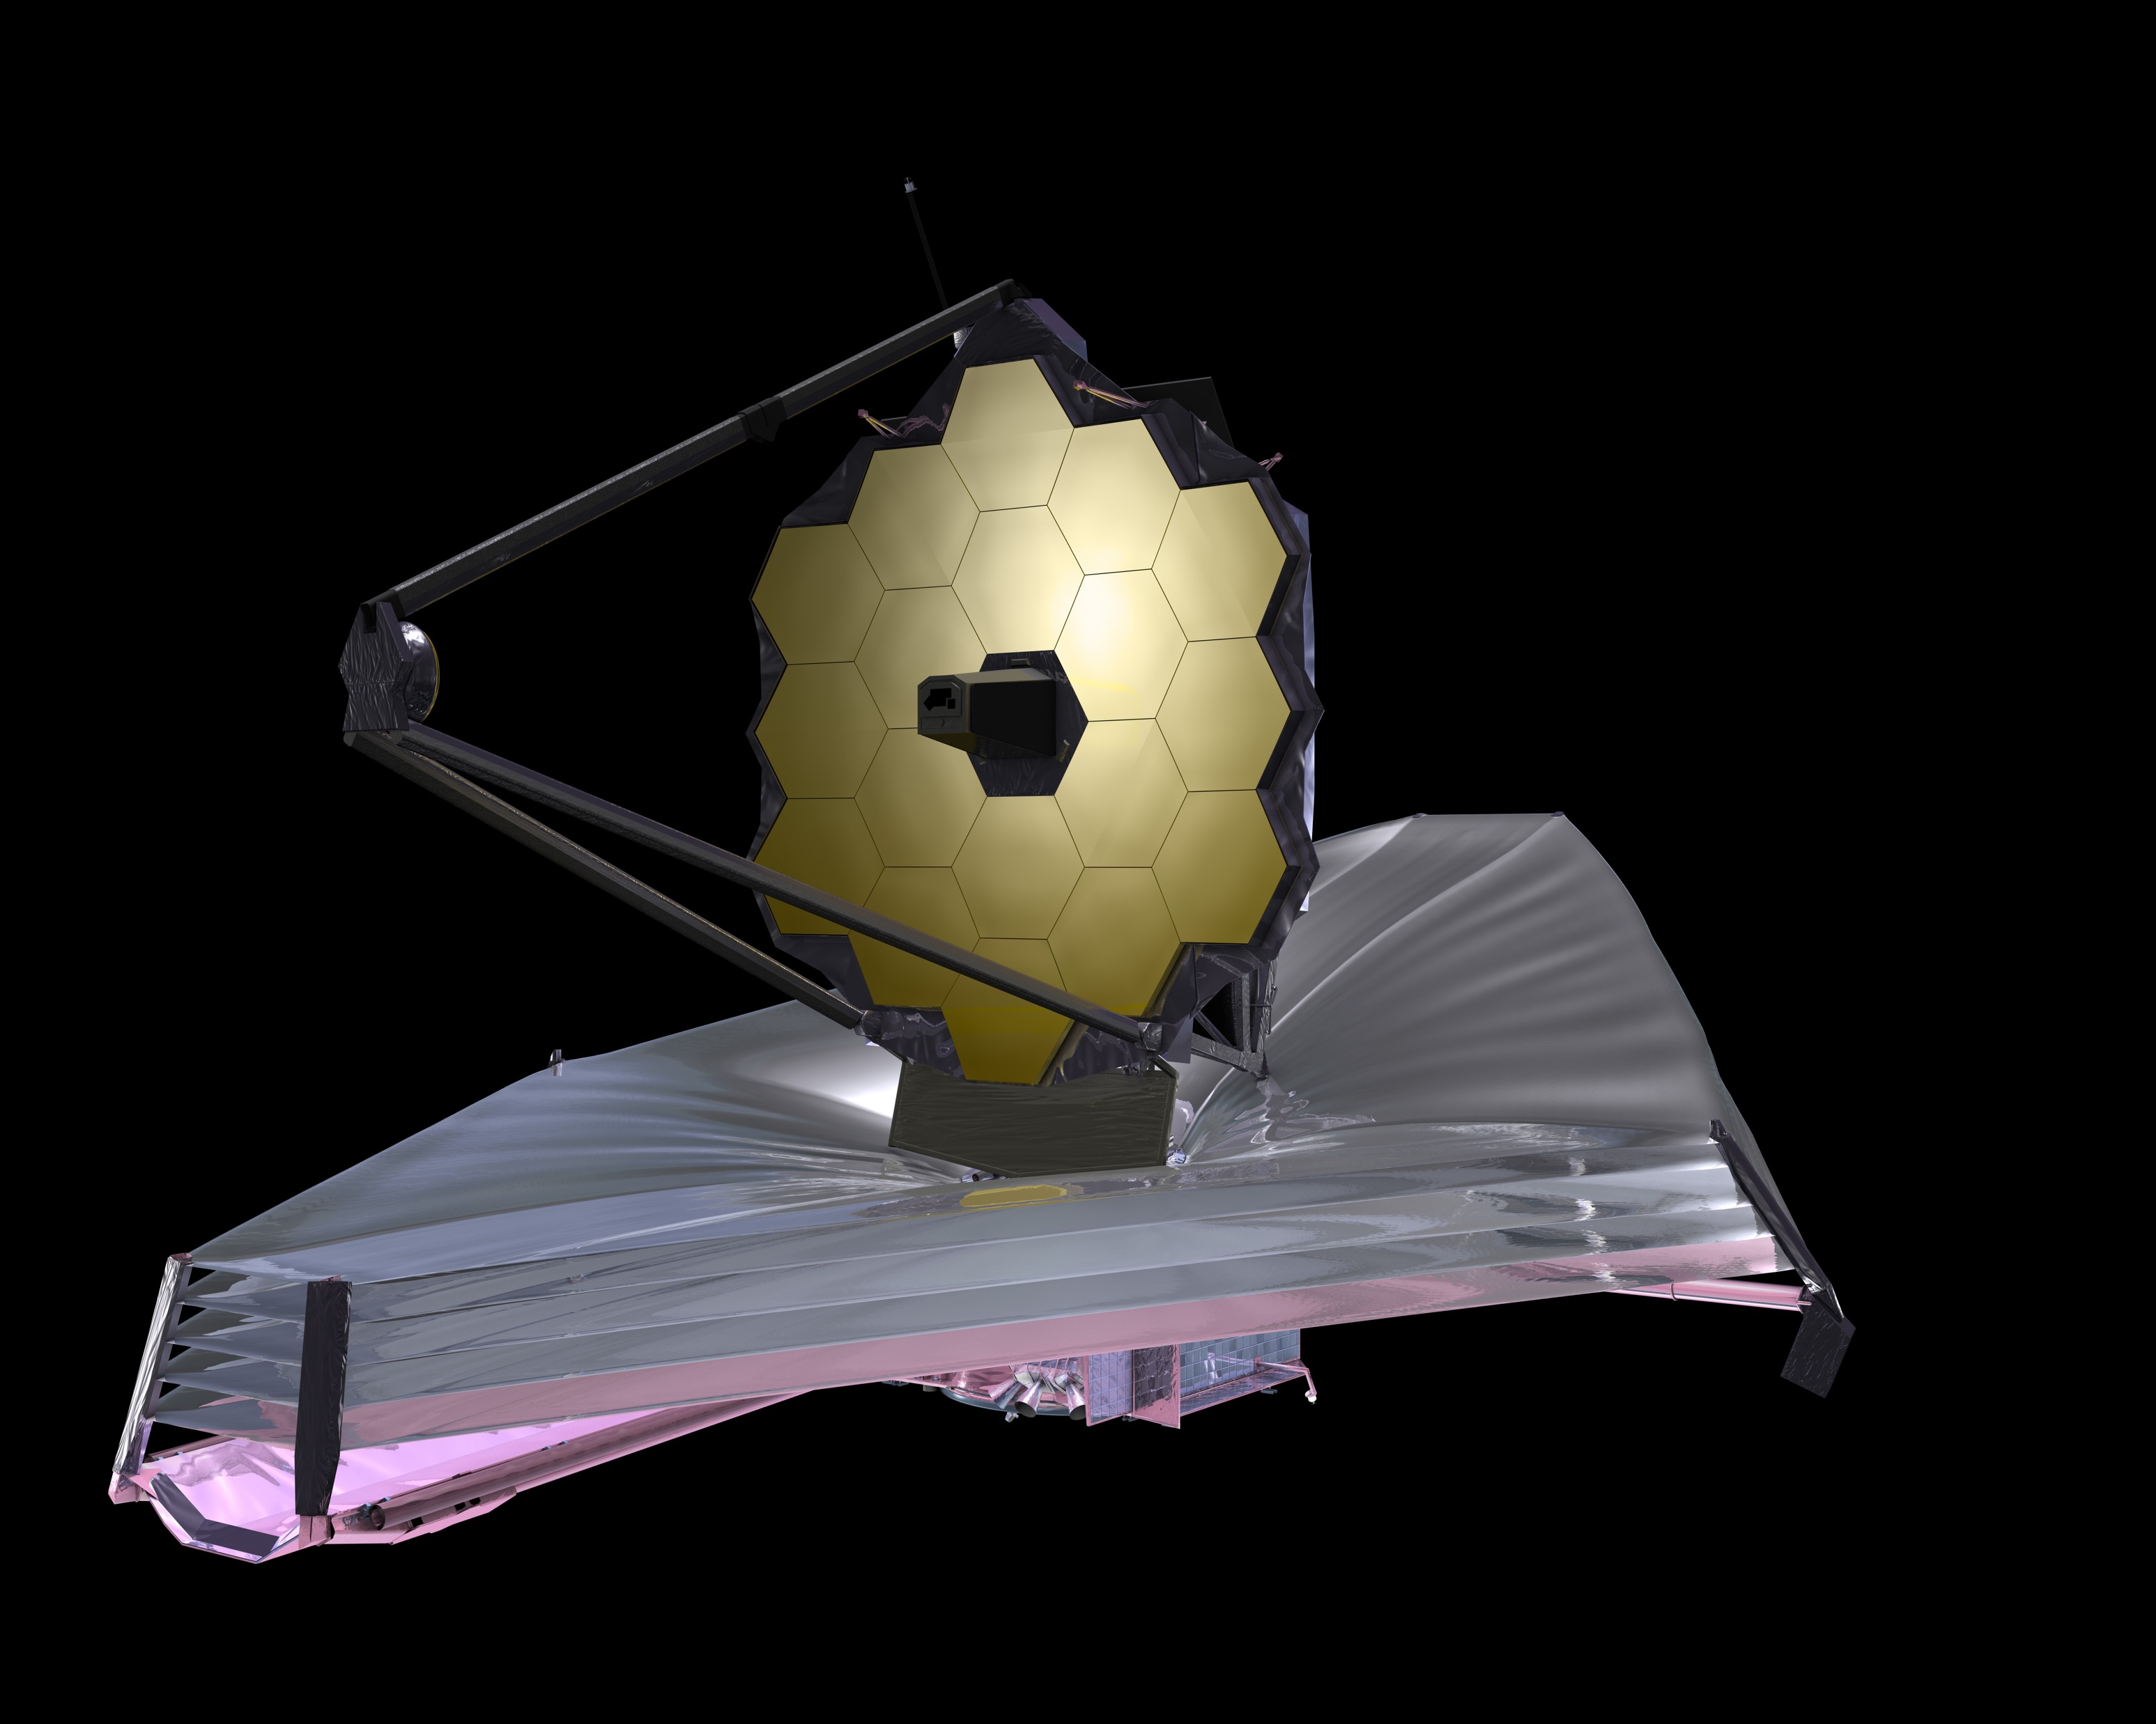
A New Era of IR Astronomy
James Webb Space Telescope (JWST)
Infrared (IR) sensitivity allows for detection of low luminosity, redshifted galaxies
High resolution further into the IR, allows for visualization of structure at high-z
Seeing structure is necessary to determine if a galaxy is merging or recently merged
https://en.wikipedia.org/wiki/James_Webb_Space_Telescope#/media/File:James_Webb_Space_Telescope_2009_top.jpg

Slide 5
Spitzer (MIPS, 24μm)
Spitzer (IRAC, 3-5μm)
JWST (MIRI, 7-12μm)
Kirkpatrick et al. 2023

Slide 6
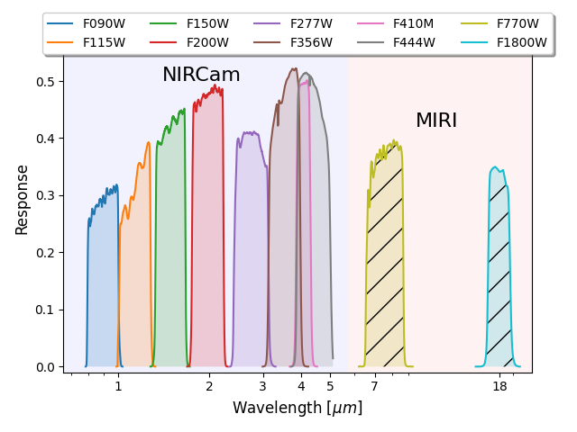
Primer: a Modern IR survey
Public Release Imaging for Extragalactic Research
10 band NIRCam + MIRI Survey in the COSMOS and UDS fields
8 NIRCAM bands, 0.9 – 4.4 μm
2 MIRI bands, 7.7 μm and 18 μm
400 arcmin² of NIRCam imaging with 230 arcmin² of overlapping MIRI imaging
Nearly 200,000 detections at 4.4 μm

Slide 7
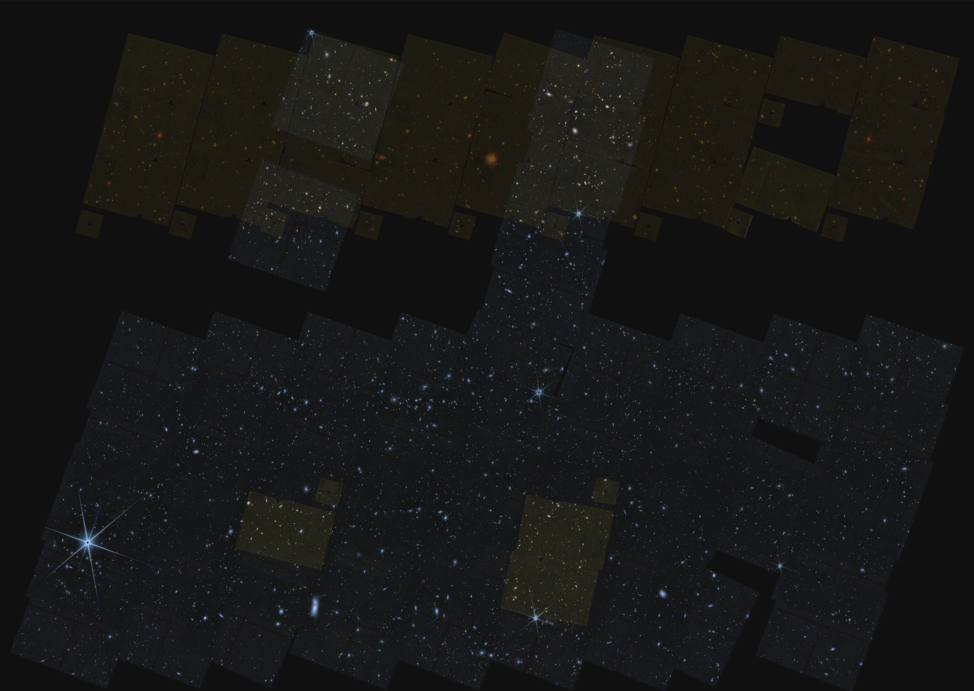
PRIMER UDS
15 arcmin

Slide 8
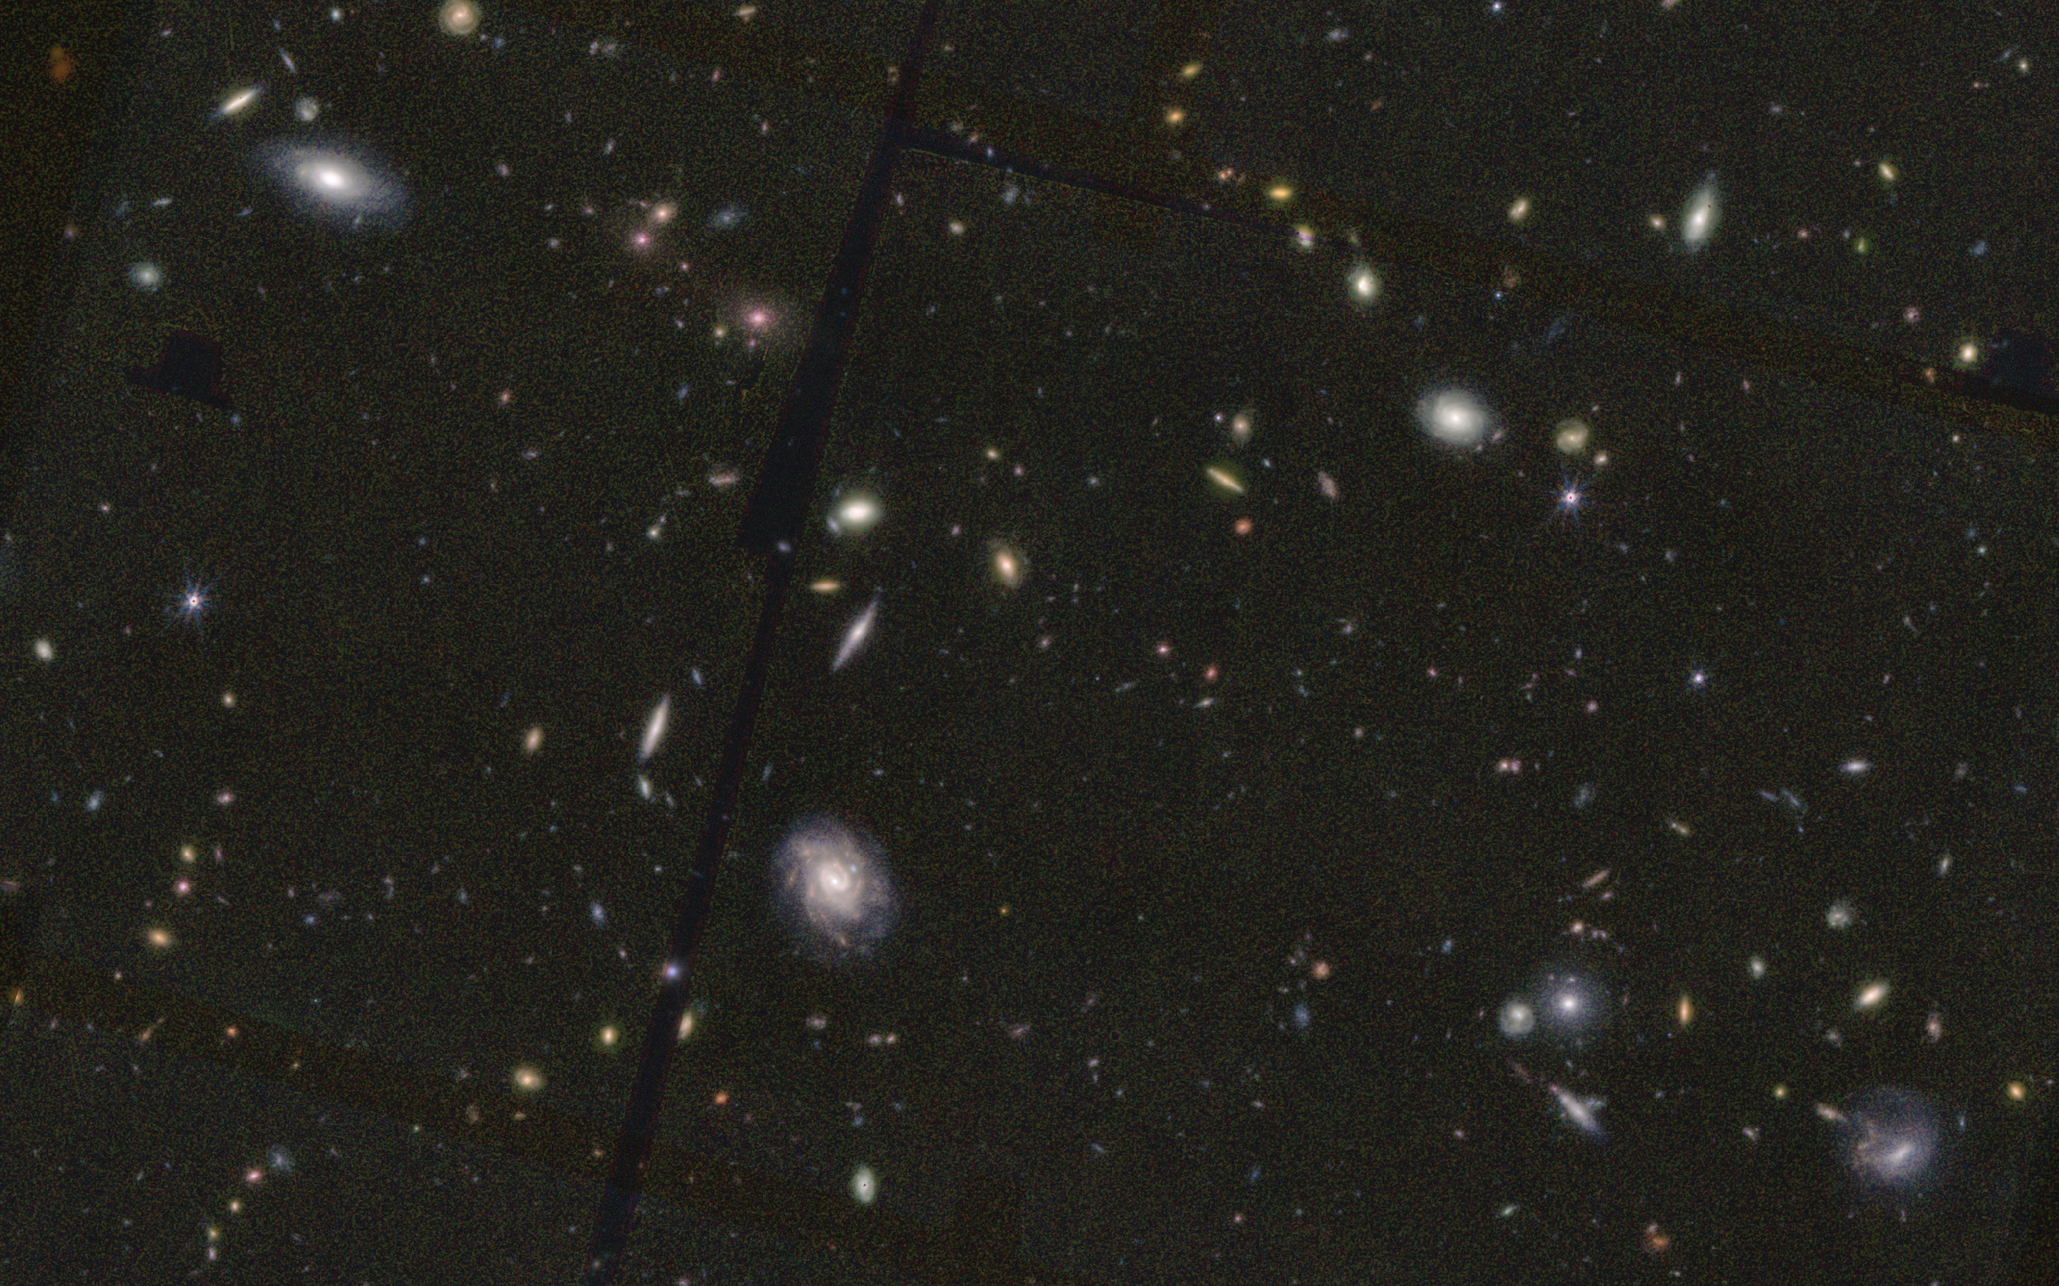
1.4 arcmin

Slide 9
My Project
Goal: Search for merger-driven AGN growth
Create a catalog of 7.7 μm -selected objects in each field
Need mid-IR to probe AGN power-law emission
IR select (through SED fitting) AGN candidates
Currently using CIGALE for this
Visually classify them to search for mergers
Using Zooniverse to classify
Visual classification the most reliable way to find mergers
With NIRCam, can get optical morphologies at high-z!

Slide 10
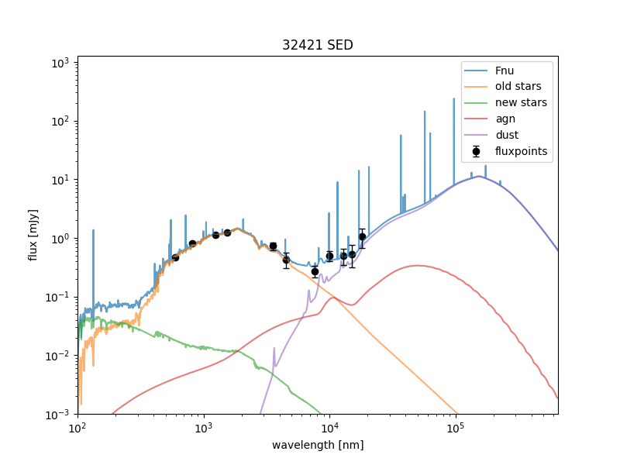
Sed fitting
Generate models of galaxy emission
AGN, dust, old stars, new stars, nebular emission, etc.
Find model that most closely matches observations
If best-fit model has AGN contribution ➔ AGN detected!

Slide 11
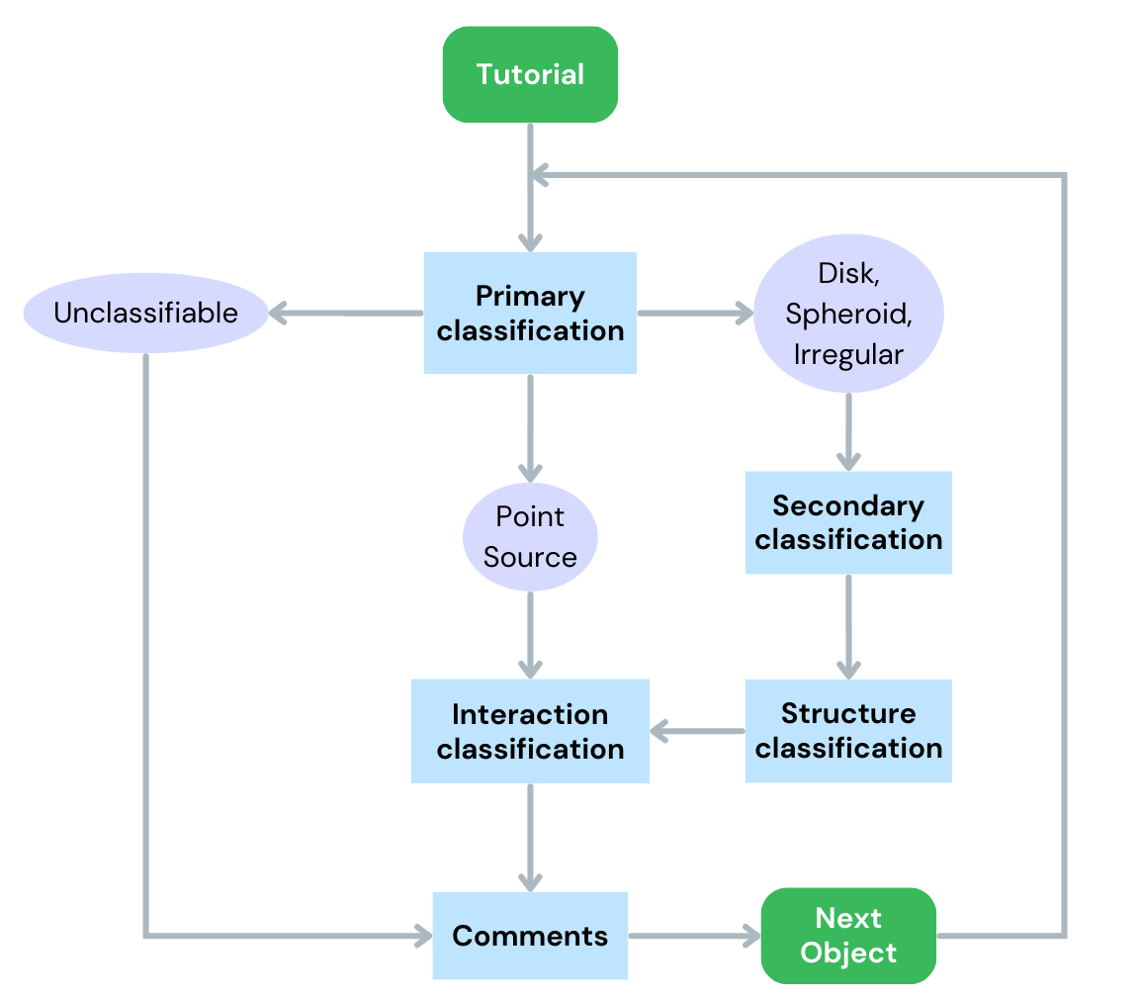
Classification scheme
Adapted from Kartaltepe, et al. 2014, but reduced for simplicity
We basically ask two questions
What does the galaxy look like?
Is it interacting with its neighbors?
Shown to be consistent with parametric and non-parametric classifications

Slide 12
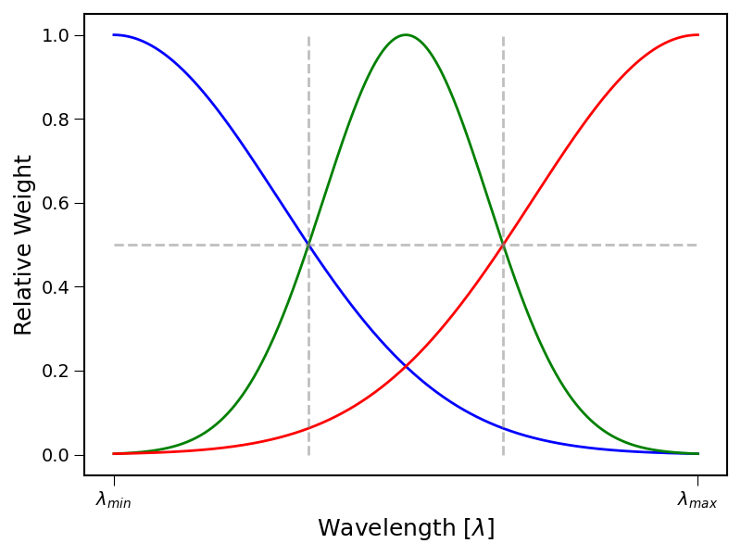
Visual Classification images
Uses modified version of trilogy
Allows multiple bands → RGB
Credit: Dan Coe
RGB made by
Define cutout
Sample cutout in all wavelengths
If data is missing in a wavelength, throw it out
Assign RGB colors to available wavelengths according to distribution shown here

Slide 14
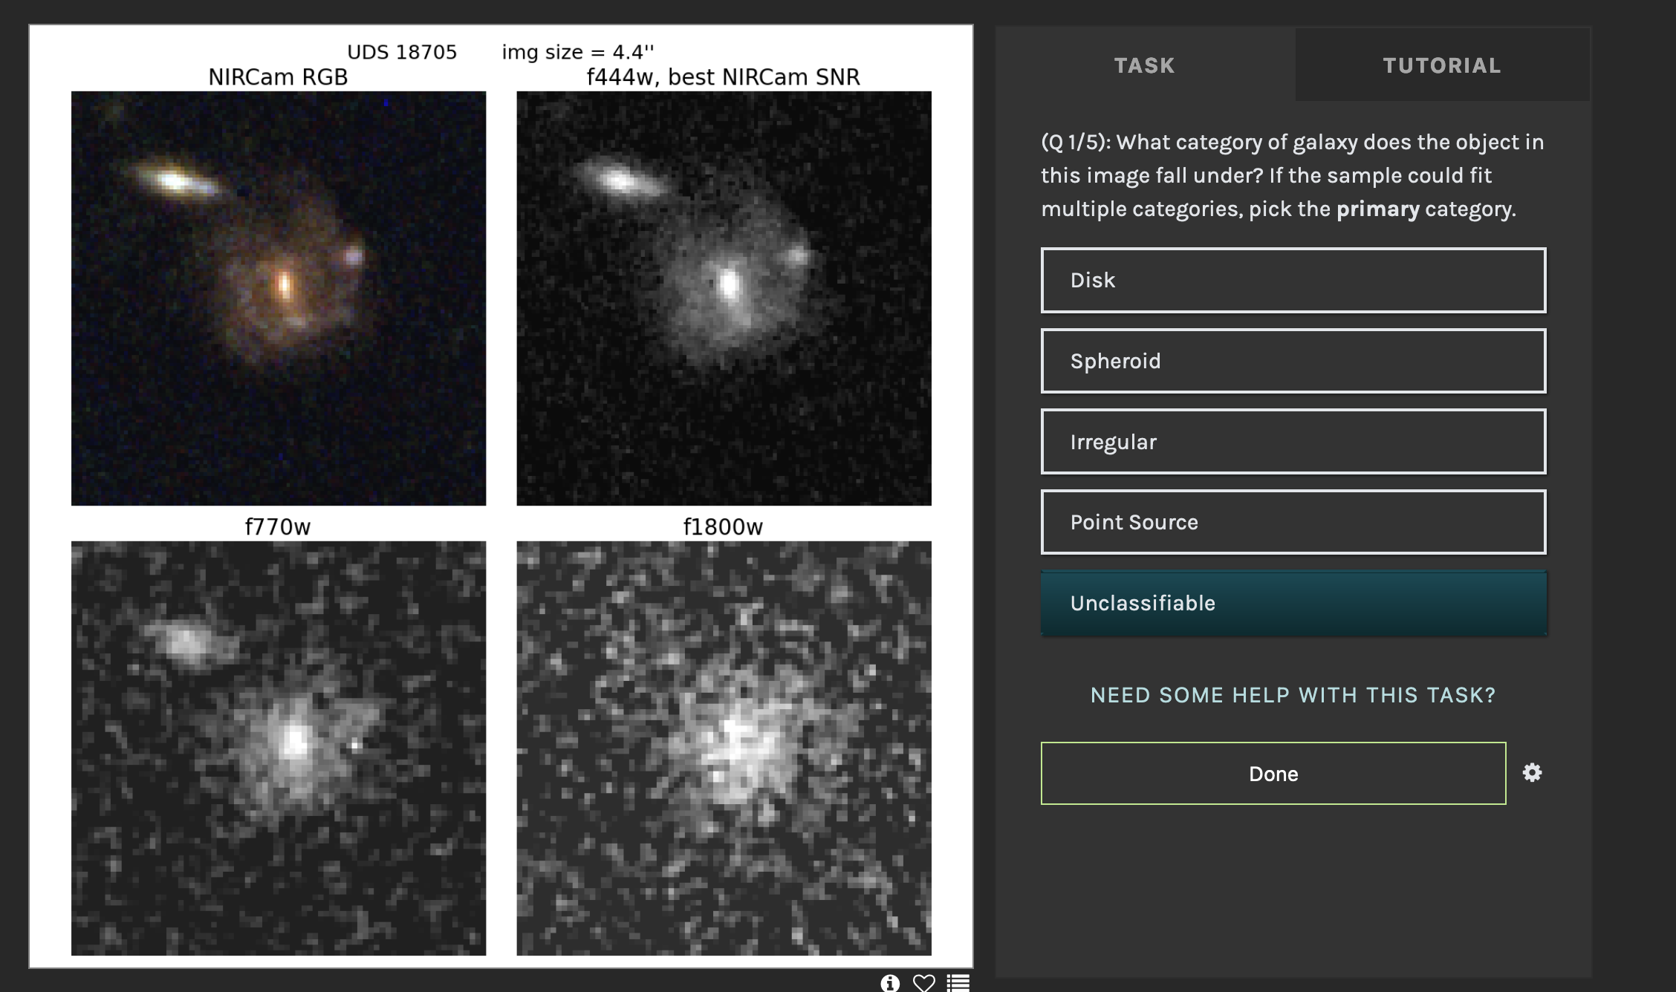

Slide 15
Current work, Future goals
Expand visual classifications to include more objects
PRIMER data is incomplete
This is what I’m currently working on
Plan to incorporate another survey as well
Apply parametric and non-parametric morphology metrics
Sérsic Fit, Gini, M20, CAS
Currently have undergraduate working on this
Once everything has been classified…
Compare merger rate in AGN population, non AGN population
Perform morphology analysis as function of redshift
Search for reasonable JWST color selection to more quickly classify mergers

Slide 16
Scan this to check out the website!

