Slide 1
Can a glacier protect itself? Viewing sikkusak (ice mélange) as a heat sink
Michael Shahin¹
Aurora Roth², Kenneth Hughes³, Leigh Stearns¹, Fiamma Straneo²
1
3
2

Slide 2
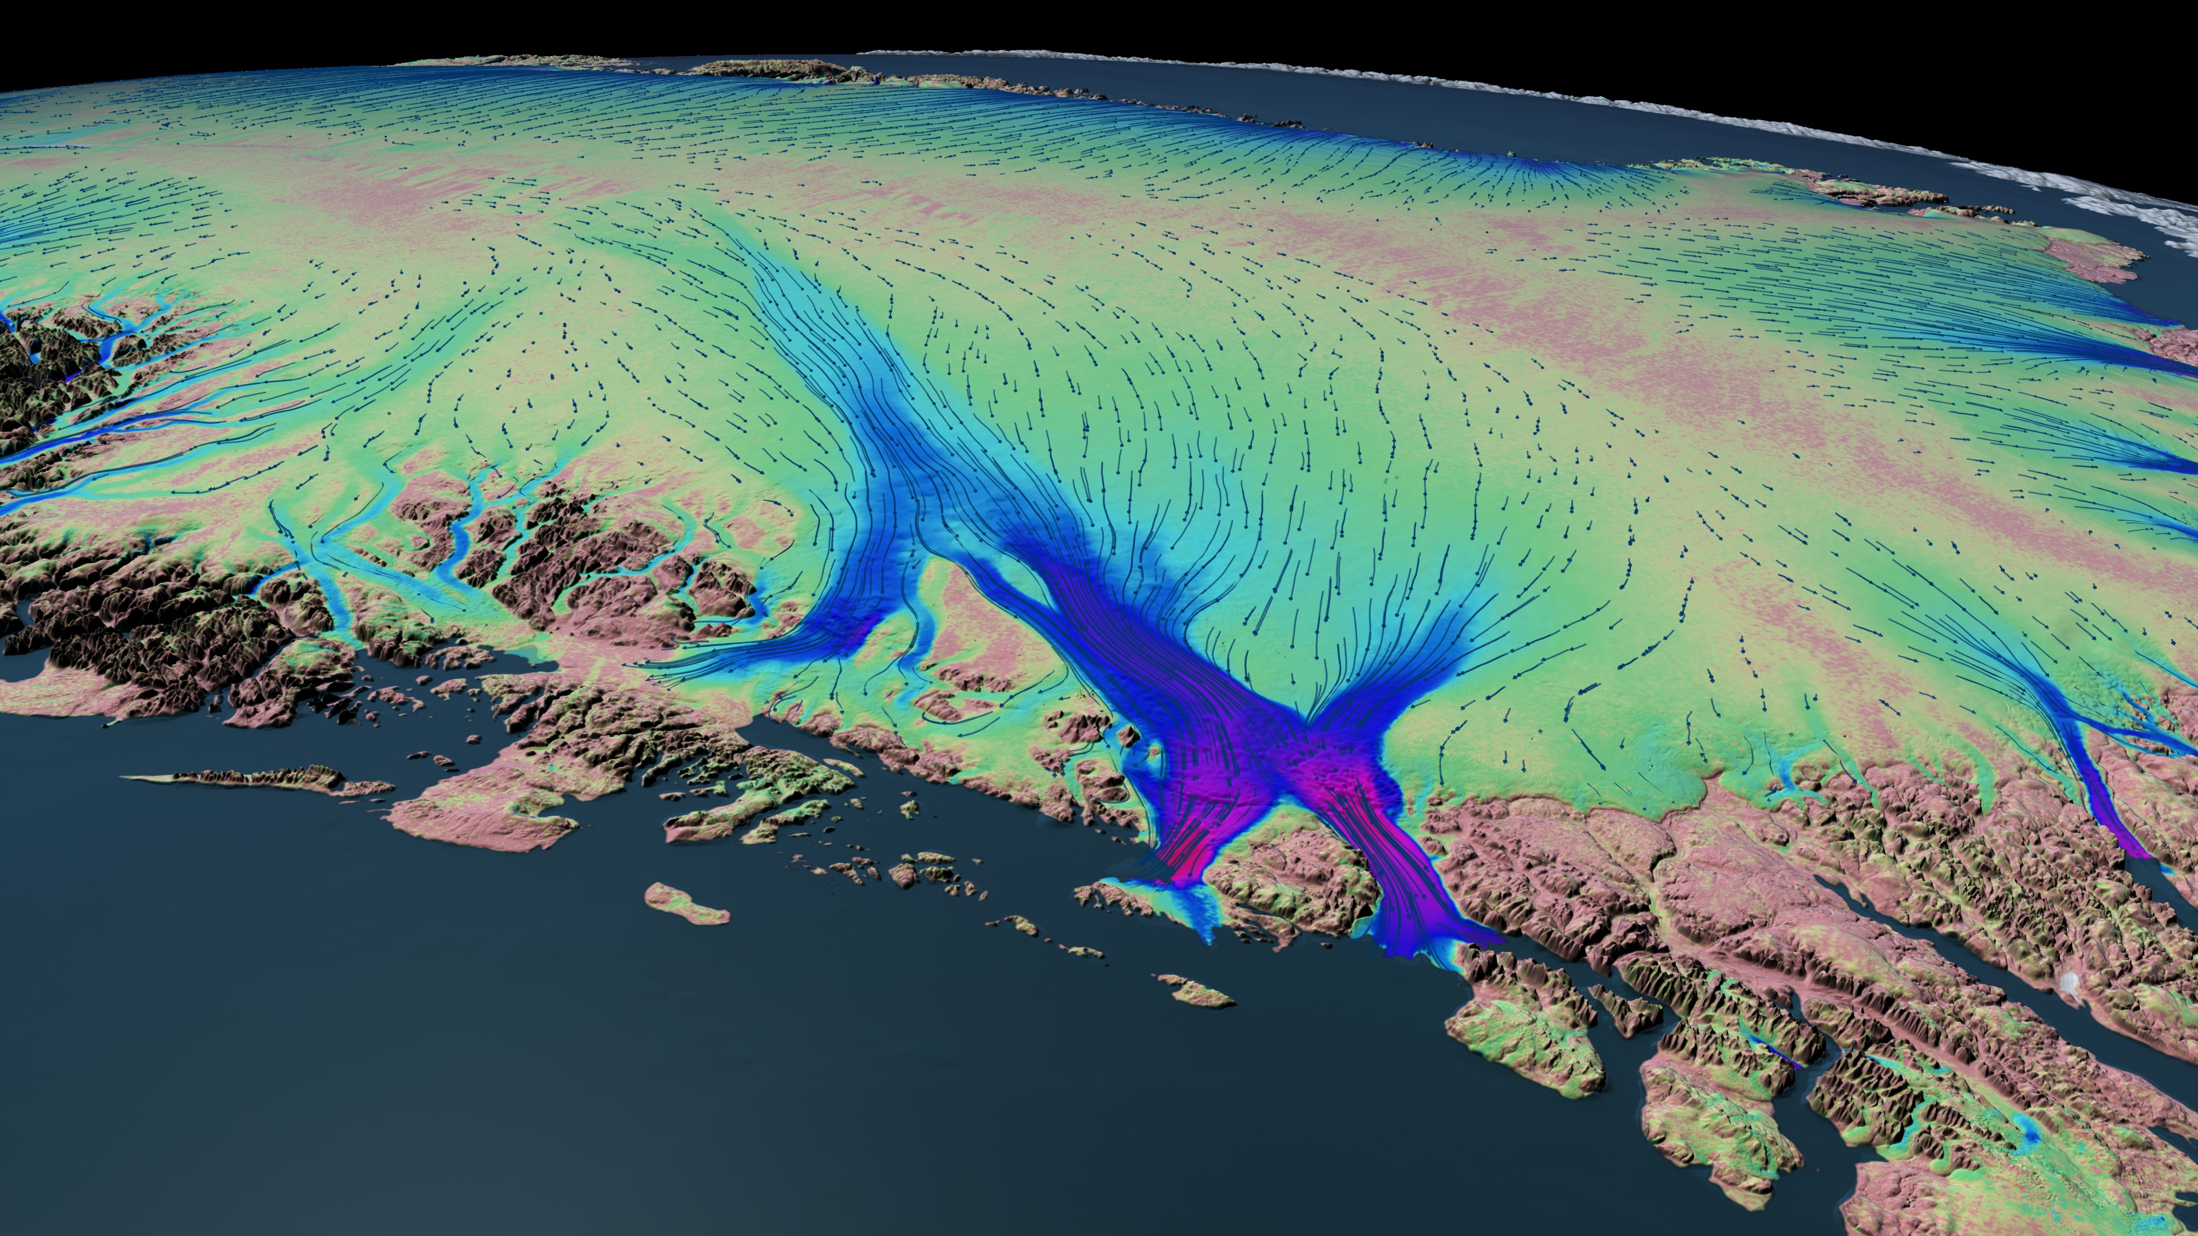
The Greenland Ice Sheet
rapid change
≈ 34 %*
Smith et al.,2015
NASA GSFC
Δ mass
≈ 66 %*
time
Figure credit: NASA and JPL/Caltech
*From Mouginot et al., 2019
Notes:
Greenland holds about 7.3 meters of sea level rise and is currently losing 269 gigatons of mass per year from 2002 – 2023, according to data from NASA’s GRACE satellites, which measure changes in earth's gravitational field.
This mass loss signal can be partitioned into to groups
Surface mass balance like surface runoff and melting which is ~34%
Ice dynamics speeding, thinning, retreating, grounding line retreat, calving which accounts for about ~66% of the mass loss
But why do glaciers speed up? This is a central question to my research and currently there are a few competing hypotheses
Namely 1) Ocean driving change at Terminus which cause acceleration and
2) Surface runoff reaching the bed and more ice-bed interactions
Is it what is happening at the front or at the bed? Both?

Slide 3
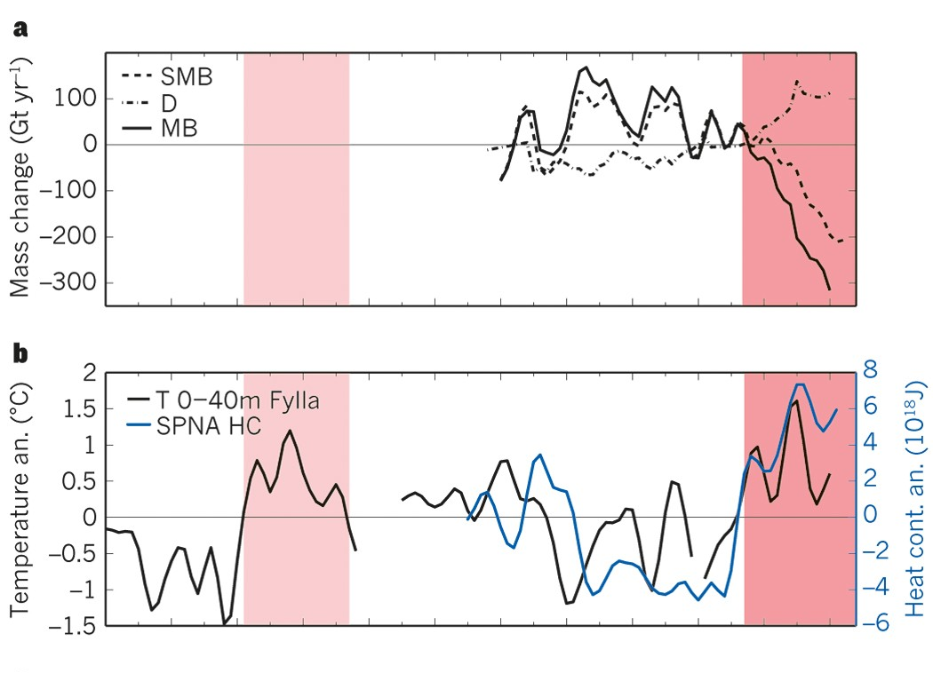
The Greenland Ice Sheet
a warming ocean
Straneo & Heimbach, 2011

Slide 4
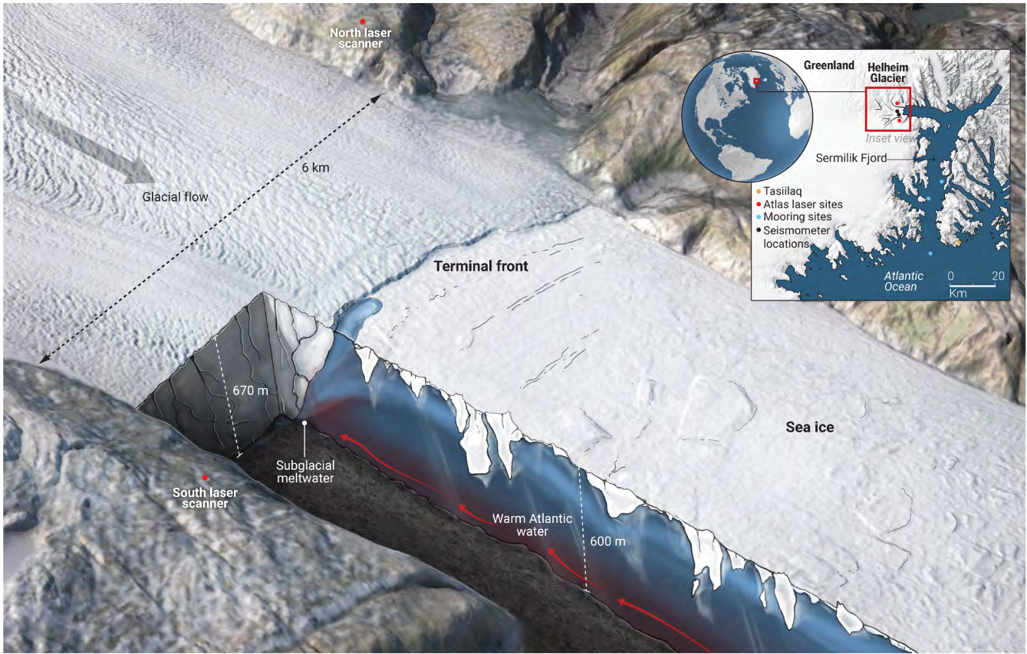
The Challenges
terminus dynamics
Can’t see key processes
Ice-bed interface
Ice-ocean interface
Minutes – years timescales
Figure Credit: Chris Bickel AAAS
Notes:
A reason why we in the glaciology community are debating these hypotheses is that we can’t see the key processes at the ice-bed interface, click
The ice-ocean interface click,
Also some process just occur really fast, instantaneously, like mélange calving interactions, and also over years to decades time scales
Explain the image a bit
This is Helheim glacier
6 km wide terminus
Ice mélange, a mixture of iceberg clasts and sea ice matrix
Cold polar water on top and warm salty Atlantic water on bottom

Slide 5
What is a sikkusak?
How do they form?
Video of Rink Isbrae, Greenland
Credit: Leigh Stearns

Slide 6
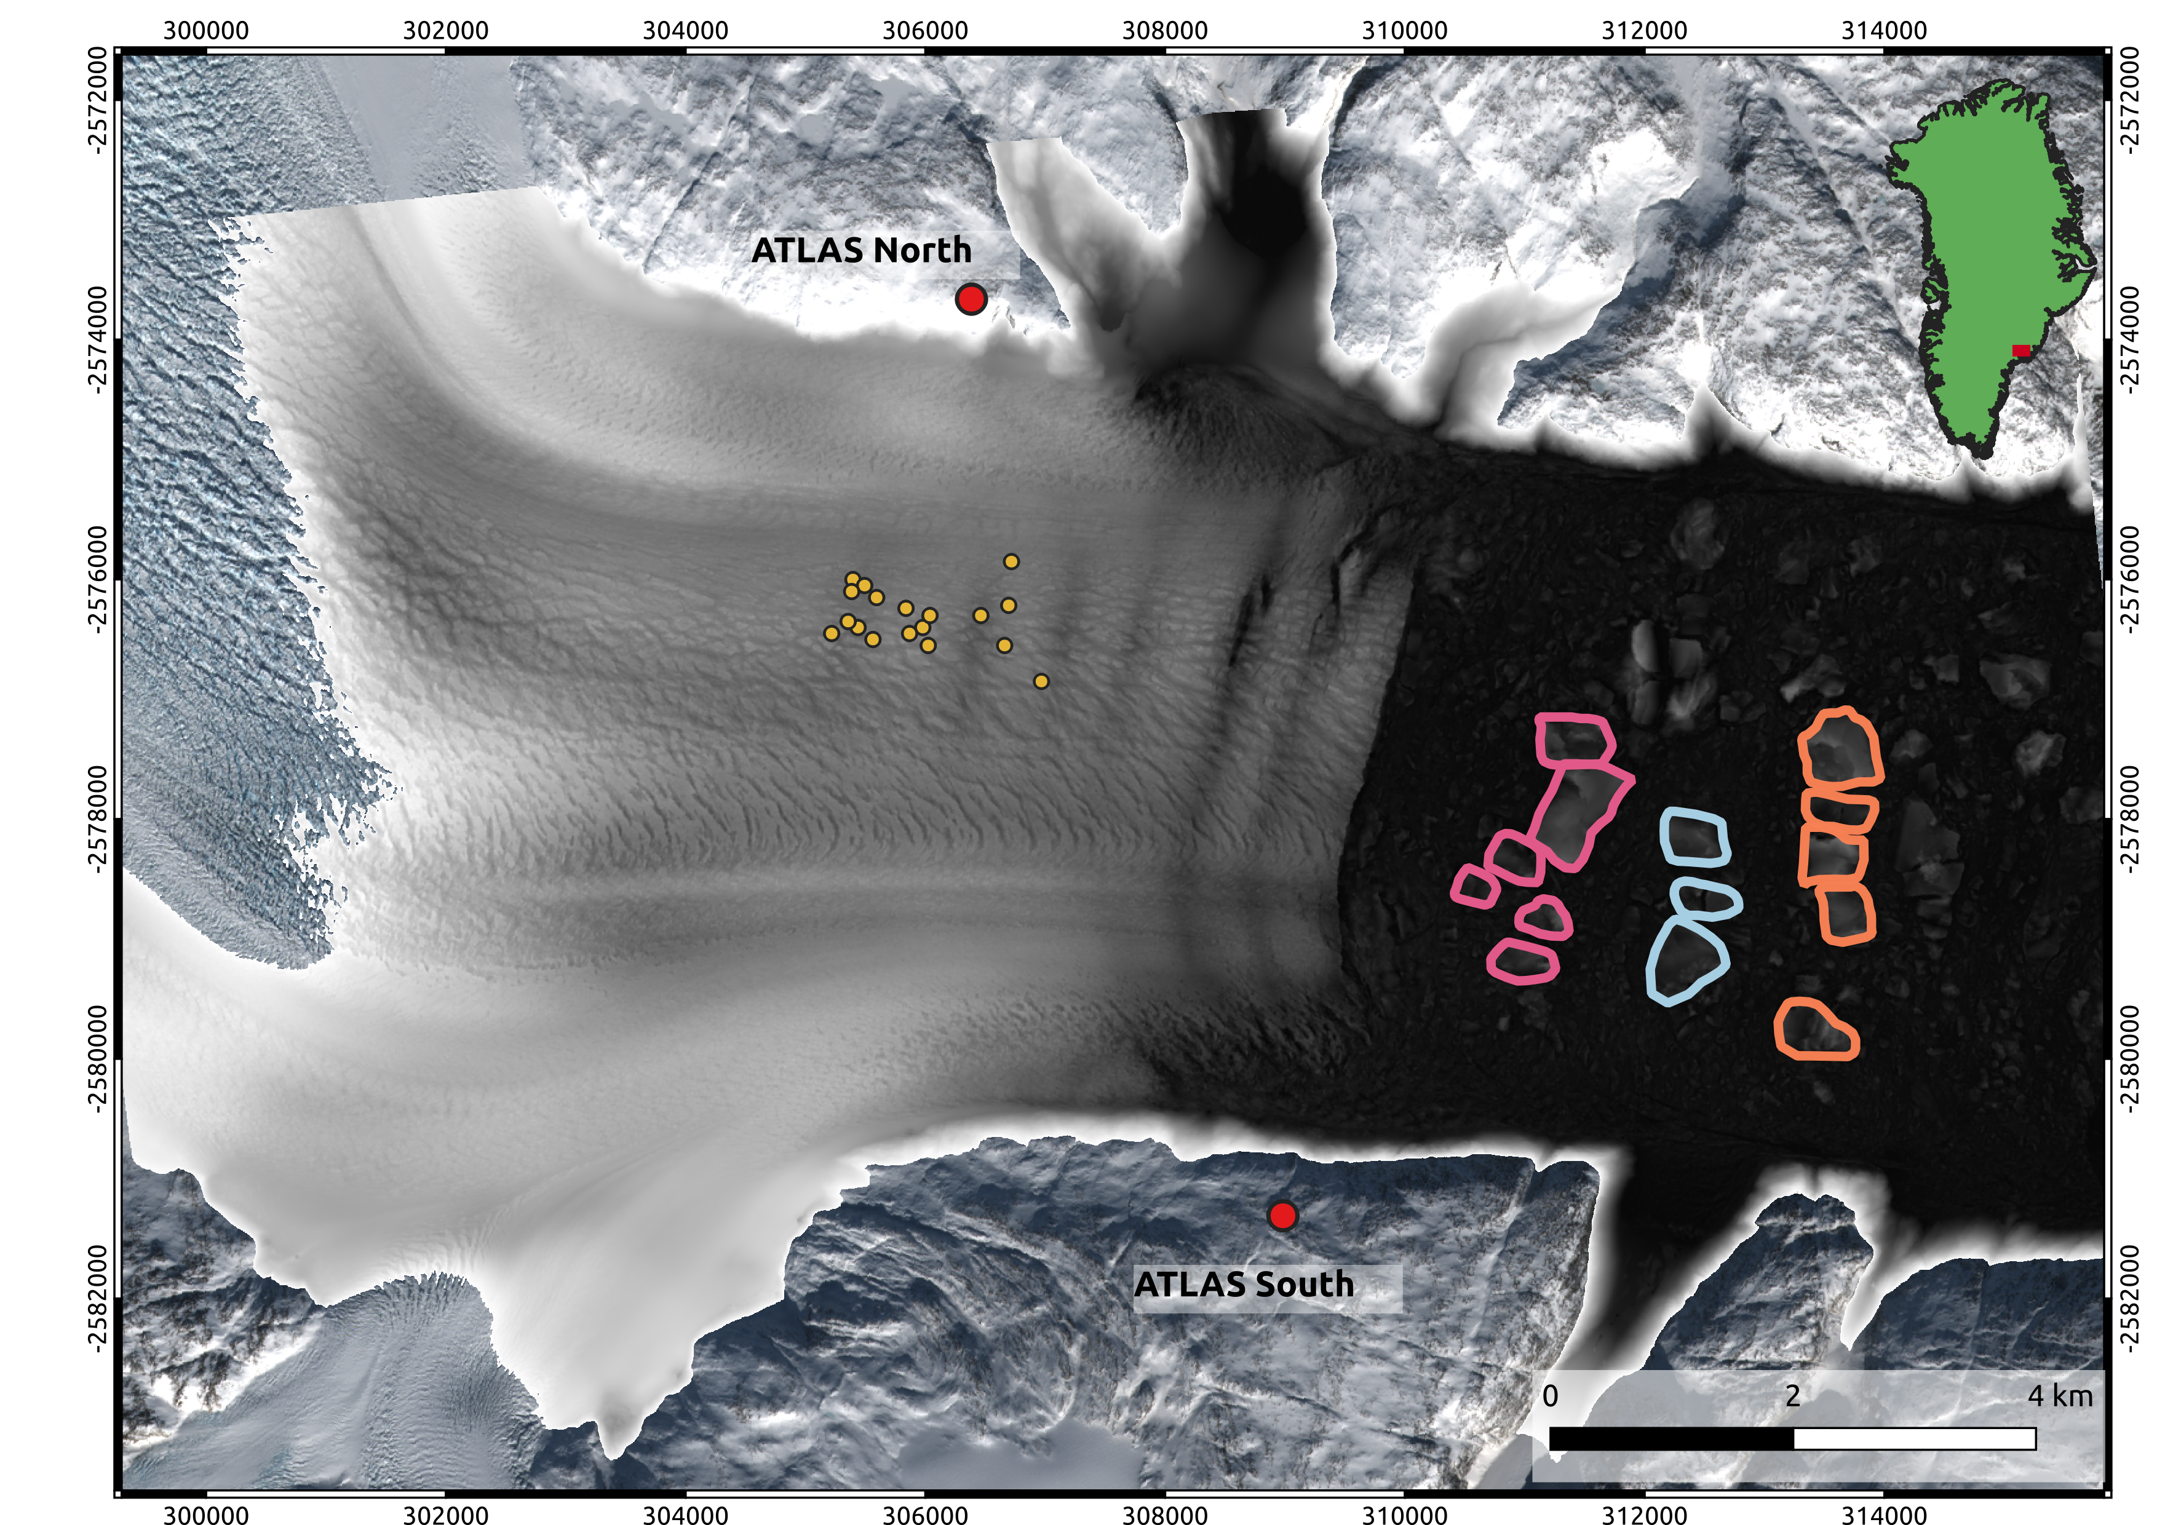
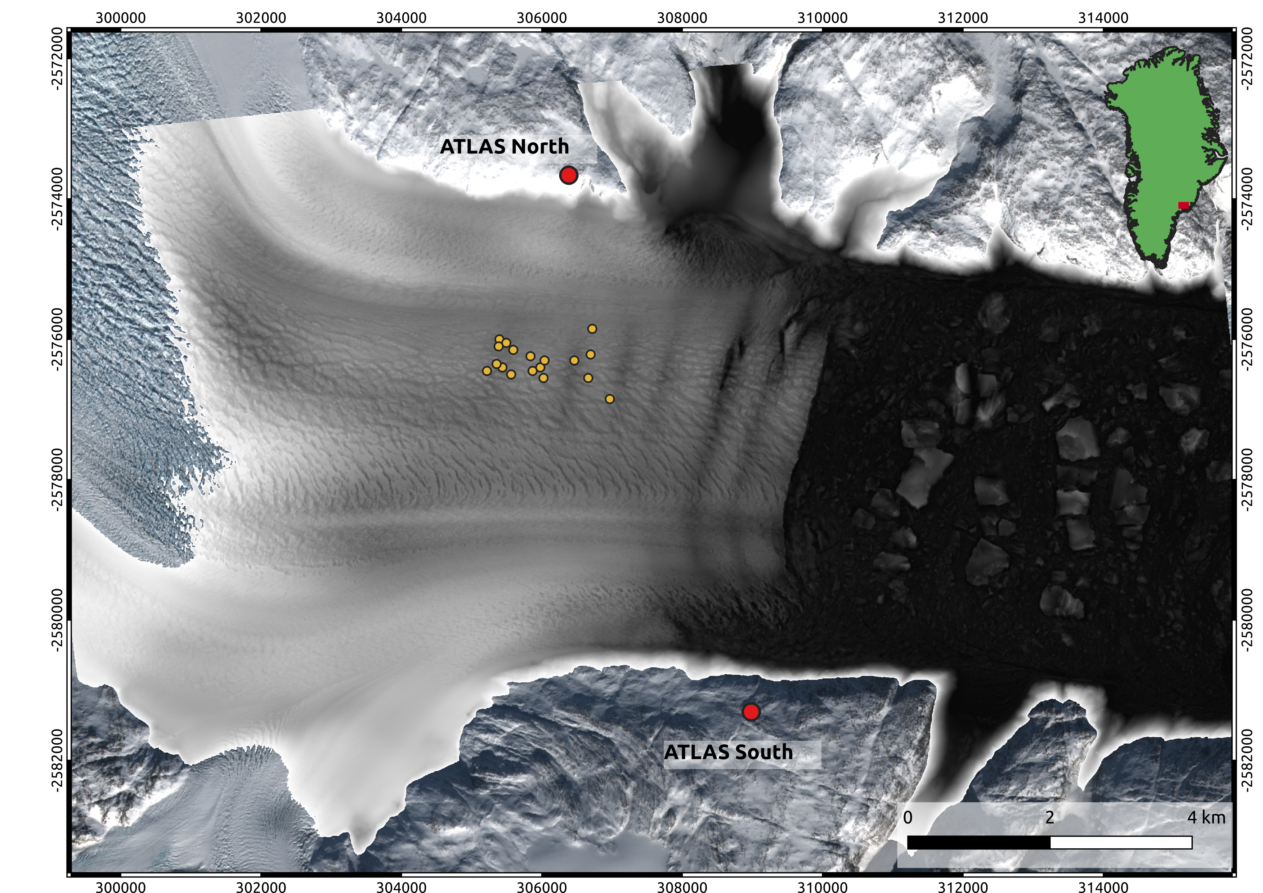
Sikkusak as a heatsink?
how can calving relate to submarine melting?
Notes:
Since calving style may not be important to ice dynamics, at least in making a strong change in velocity at Helheim during the ATLAS record, it may still impacts the glacier in other ways.
We’ve seen this dem many times now, but I want to draw y’alls attention to the icebergs in the mélange. CLICK
We see that there are bands of icebergs clustered together and these represent previous flexure style calving. Noticing this made me curious about how these large icebergs can impact the warm Atlantic waters from melting Helheim’s submarine glacier face.

Slide 7
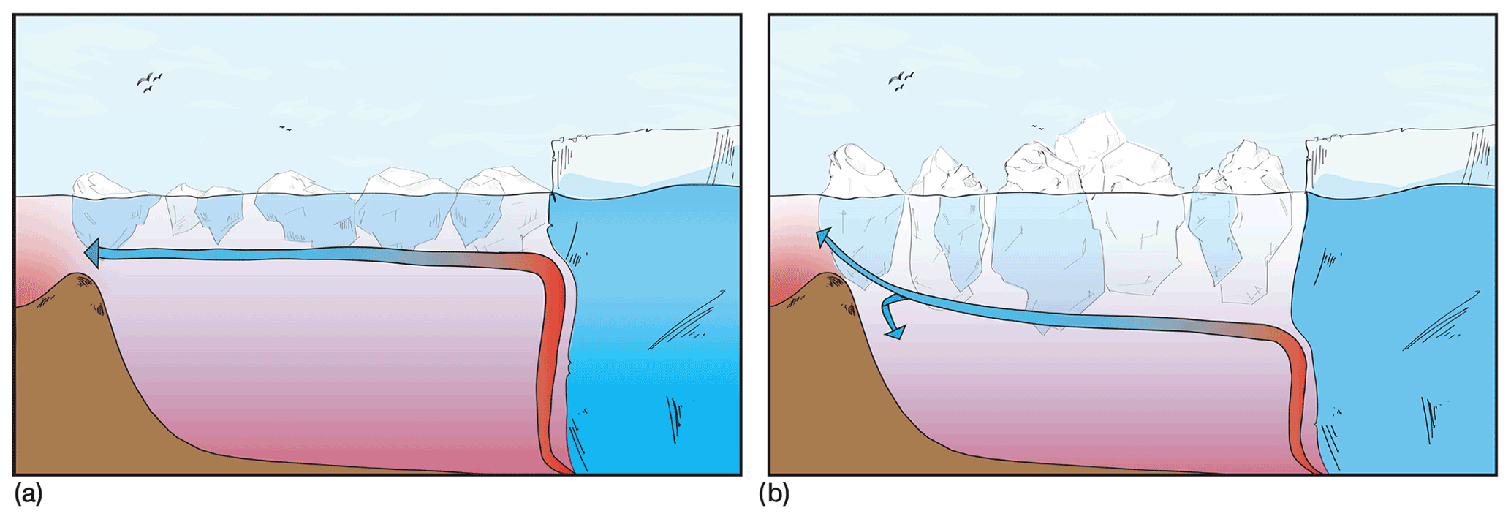
Sikkusak as a heatsink?
a versatile character
Terminus advancement correlates with thick mélange and retreat with a thin mélange
Developed a new parameterization to quantify mélange buttressing in models
Kajanto et al., 2023
Meng et al., in review
Notes:
I want to briefly mention how a mélange is typically thought of from a glaciological perspective as a buttressing force against a glacier. We currently have a paper under review which maps and highlights how mélange thickness correlate's with terminus advancement and retreat. CLICK
Also how iceberg depth can modify subglacial plume height which can also control undercutting from the plume. This beautiful figure from Kajanto et al., illustrated this concept and also high lights the importance of terminal moraines (or sills) in this process too. SHOUT OUT to Mikayla for studng this process and sedimentation.

Slide 8
How much Atlantic water reaches the terminus?
Atlantic warm water heatflux
psw – density of saltwater
Cp – specific heat of water
T – water temperature
Tf – freezing point
u – water velocity
A – Gate area
Qib
Iceberg heatflux
Figure Credit: Chris Bickel AAAS
Qaww
Jackson et al., 2014
Notes:
Looking at the schematic on the right we see the warm salty more dense Atlantic waters on at the bottom of the fjord. We call the heat being transported towards the glacier from the Atlantic waters atlantic warm water heat flux Qaww, which is defined by this integral up here. Where we integrate the heat over a gate outside of Helheim Fjord. And iceberg heatflux as Qib which we integreate the melt rate over an iceberg and get the amount of watts, energy over time that was required to melt the iceberg.

Slide 9
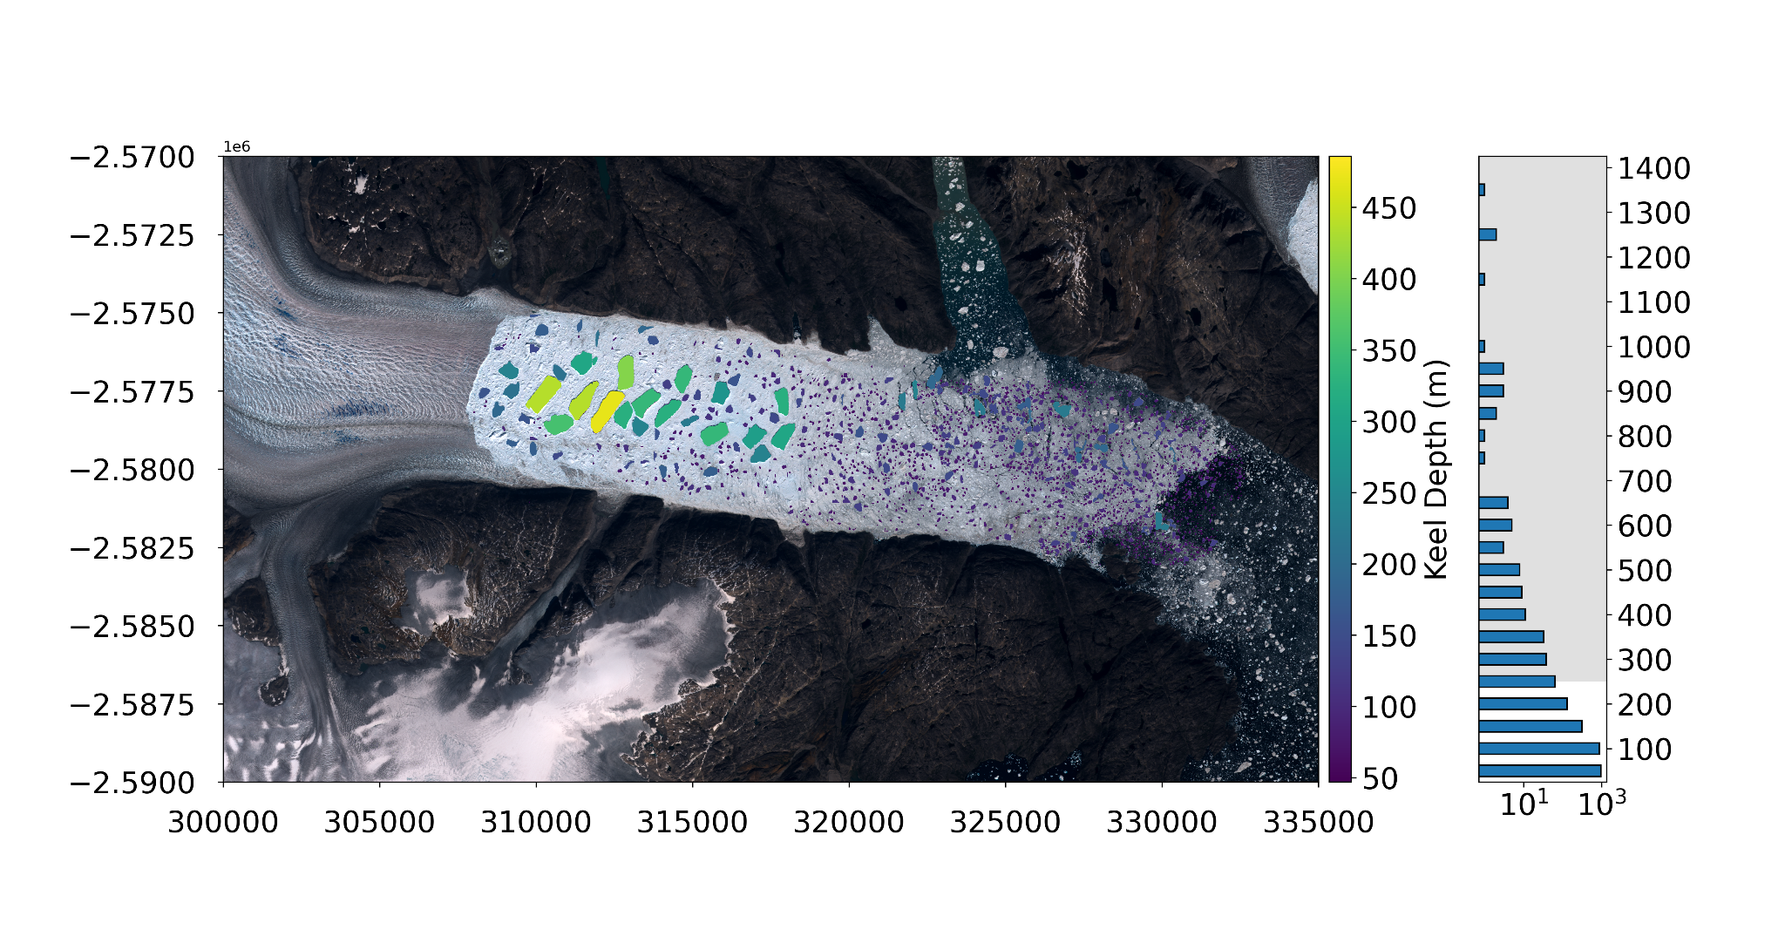
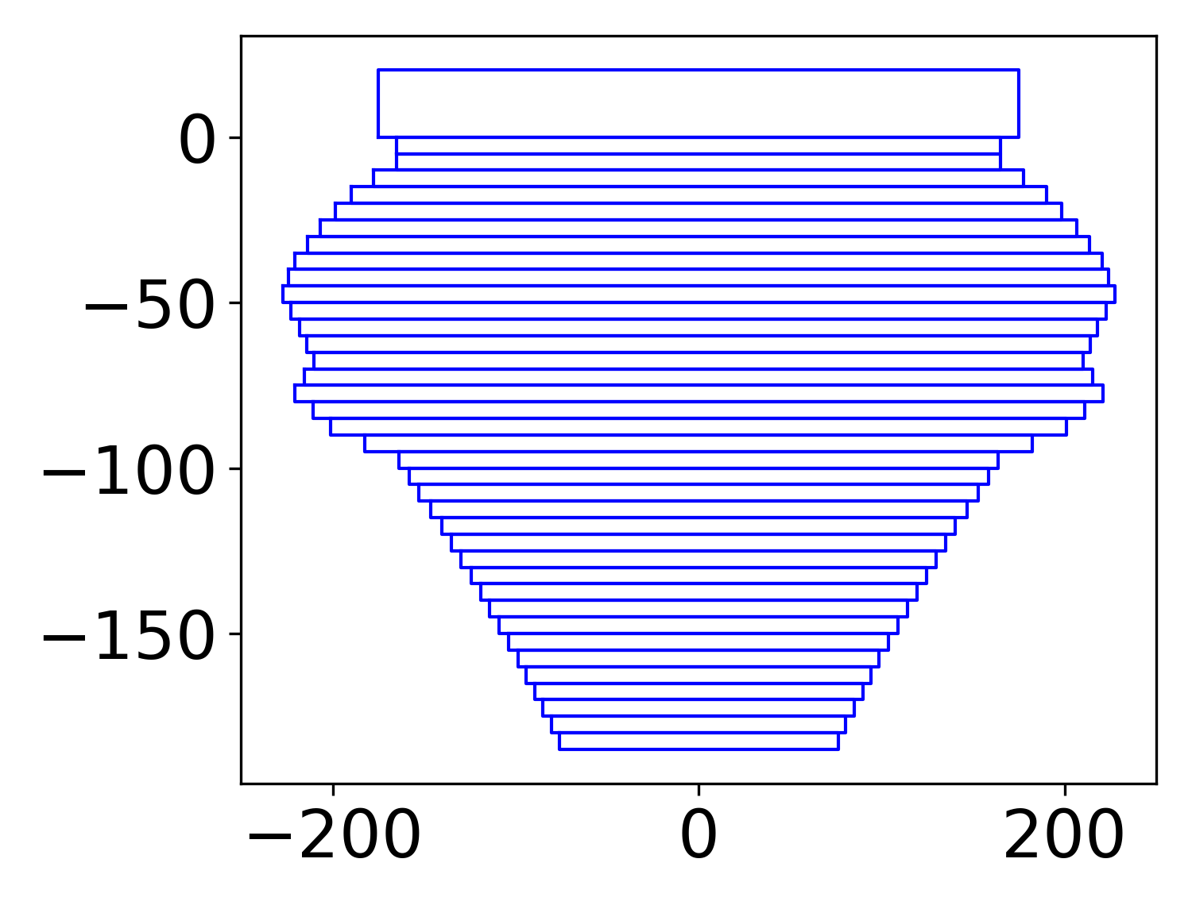
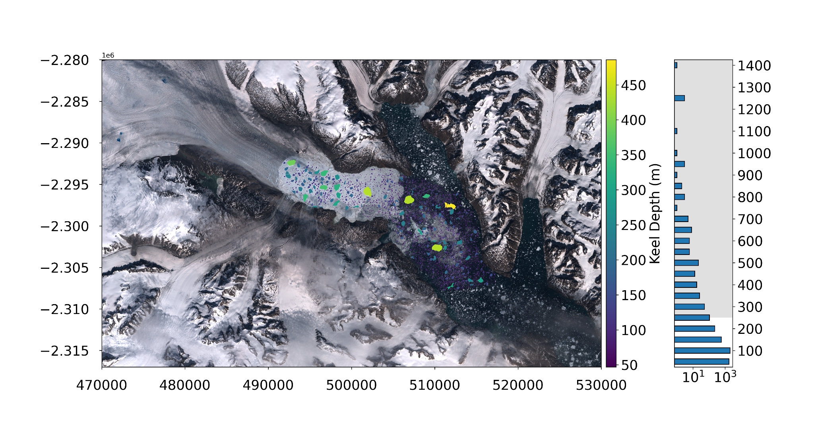
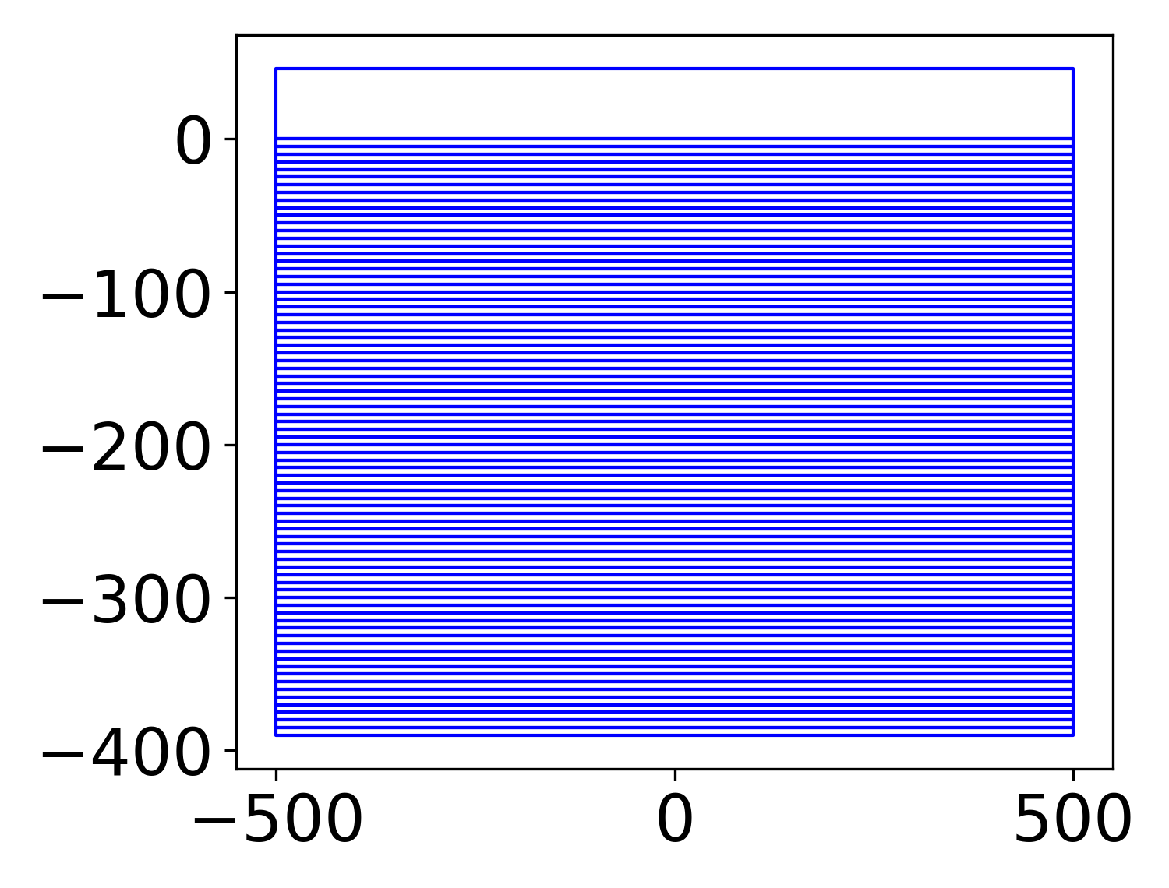
Some help from AI
Helheim
Kangersertuaq
depth (m)
Iceberg length
Iceberg length
depth (m)
Shahin et al., in prep b
width (m)
Notes:
To think about mélange as a heat sink, I first had to integrate iceberg shape and volume distributions to an ice berg melt model which I modified from Moon et al., 2018. I use META’s new segment anything model to automatically segment the icebergs, though I added a few missed bergs manually. The bar graph on the right of the images shows the keel depth distribution and the shaded area is where the icebergs intersect with Atlantic waters. I then apply these iceberg areas to the iceberg melt model which calculates iceberg volume based off of Barker et al., 2004. Though after a 400 m surface length, the icebergs become cubes.

Slide 10
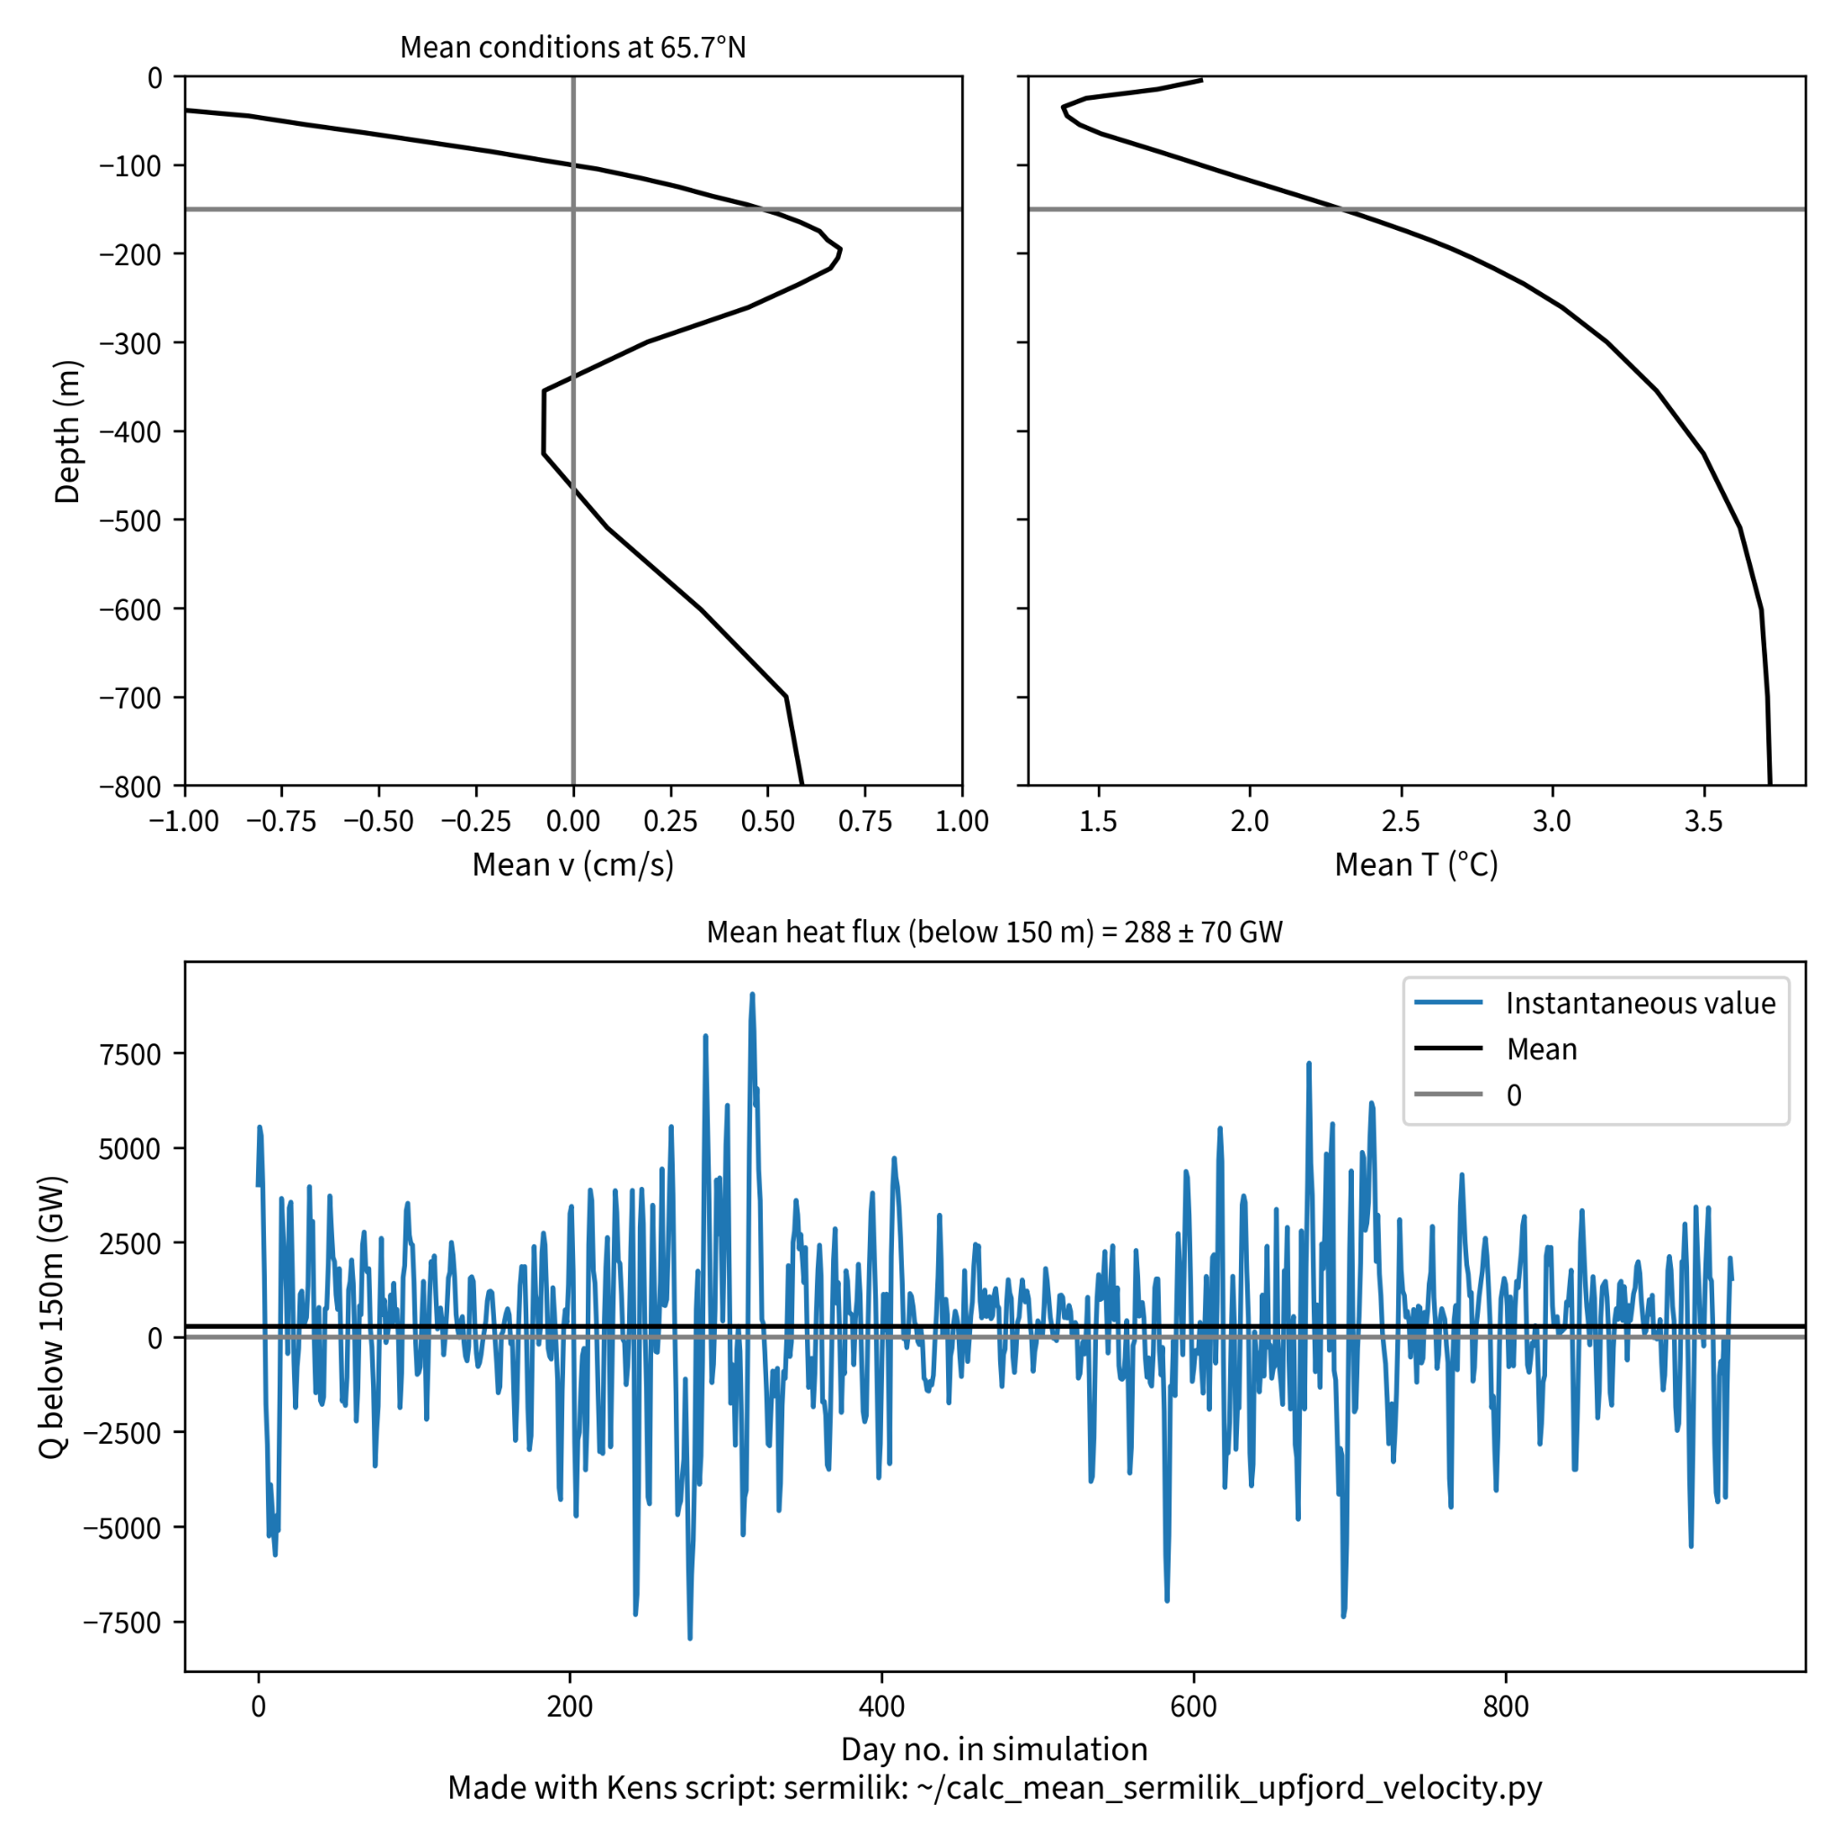
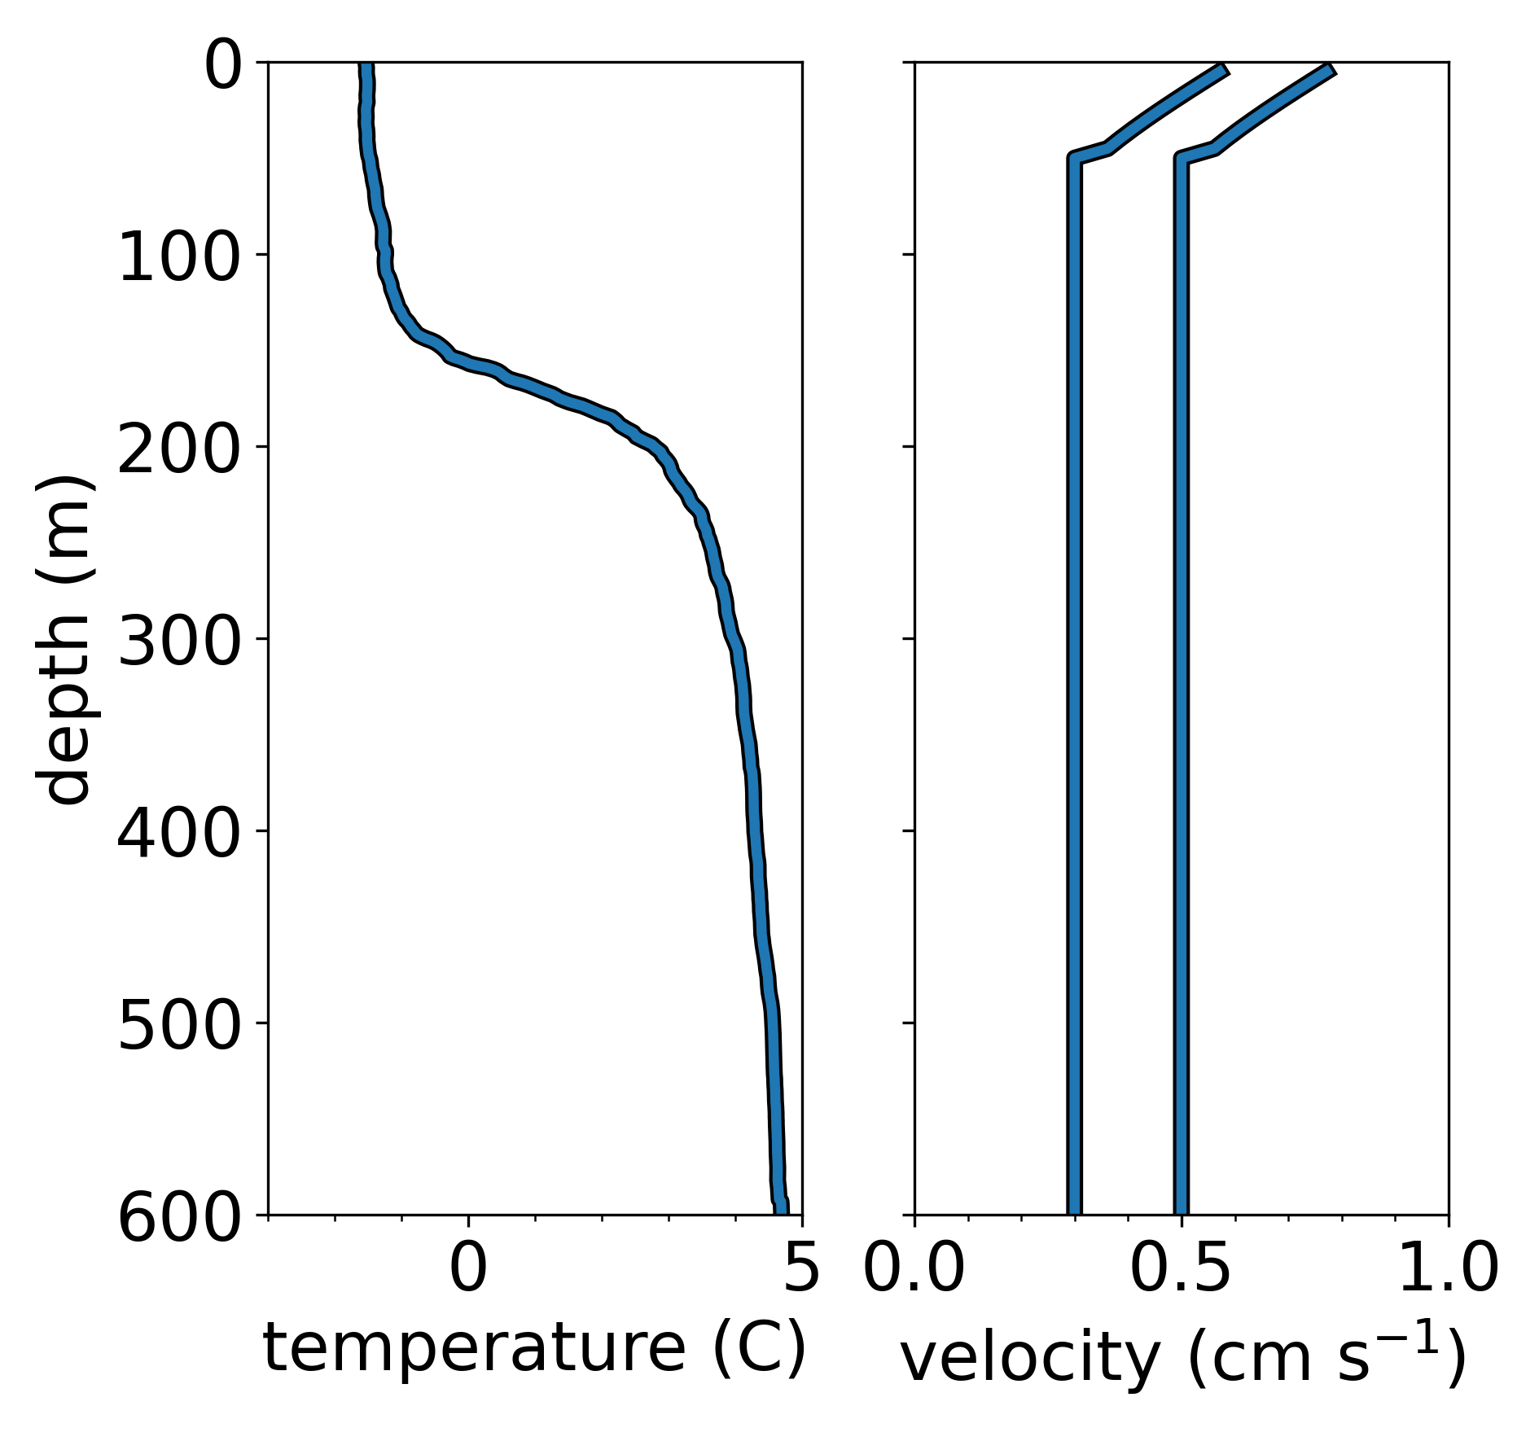
Do we know the ocean conditions?
OMG CTD*
Fixed velocity
*Oceans Melting Greenland Conductivity, Temperature, and Depth
Notes:
We also need to know the conditions of the waters. My collaborator Kenneth Hughes at the Oregon state university has helped me with this. His figures on the right, show an averaged fjord velocity, an average temperature, and average Atlantic warm water heat flux. On the right is an example of a CTD cast in Helheim Fjord from NASA’s Oceans melting Greenland campaign (OMG) and fixed velocities based on Ken’s model outputs.
Put equations back here and point towards
Some discussion about what to do

Slide 11
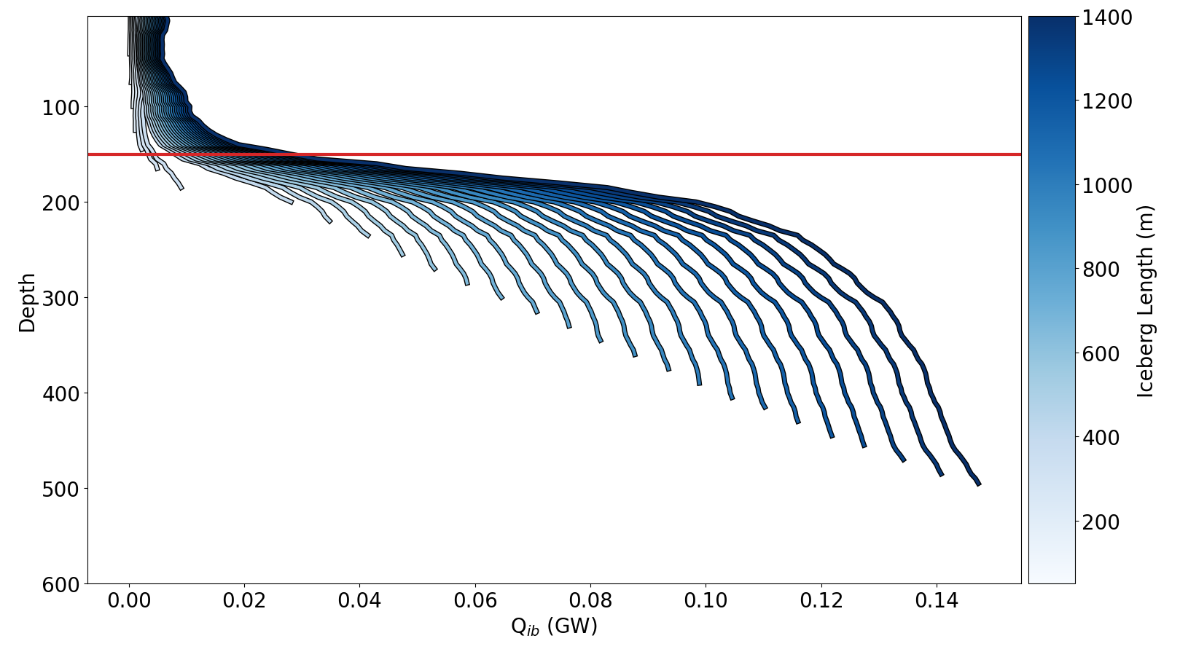
How much heat do icebergs take?
Shahin et al., in prep b
Notes:
Here are two waffle plots showing how much heat is available from warm Atlantic waters for Helheim Glacier and Kangersertuaq glacier. Each block represents 10 gws which is equivalent to melt roughly 1 cubic kilometer of ice per year. CLICK
The dark blue squares show how much heat icebergs can take up from Atlantic waters using the traditional transfer coefficient values.

Slide 12
How much heat do icebergs take?
Kangersertuaq heat data comes from Inall et al., 2014
≈ 1 km³ yr⁻¹
Shahin et al., in prep b
Notes:
Here are two waffle plots showing how much heat is available from warm Atlantic waters for Helheim Glacier and Kangersertuaq glacier. Each block represents 10 gws which is equivalent to melt roughly 1 cubic kilometer of ice per year. CLICK
The dark blue squares show how much heat icebergs can take up from Atlantic waters using the traditional transfer coefficient values.

Slide 13
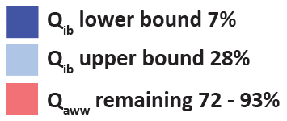
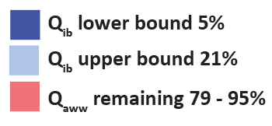
How much heat do icebergs take?
x4 heat and salt transfer coefficients
≈ 1 km³ yr⁻¹
Shahin et al., in prep b
Notes:
When updating the transfer coefficient values to make the melt rates match more recent observational studies of submarine ice melt like Jackson et al., 2020, we get much more heat taken up by icebergs. 28% at Helheim and 21% at Kangersertuaq.

Slide 14
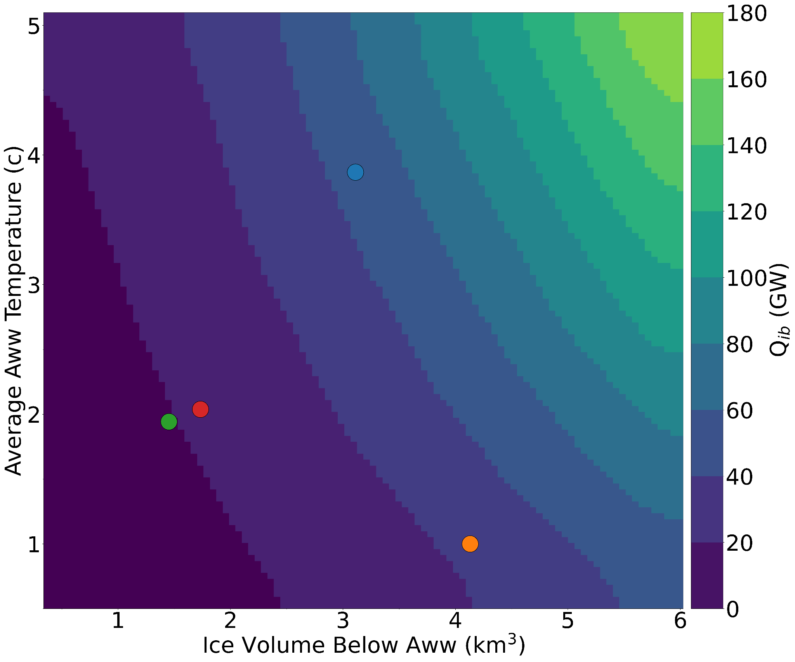
Parameter space of iceberg heatflux
Fixed fjord velocity at 0.35 cm s⁻¹
Shahin et al., in prep b
Notes:
Since our iceberg heat flux methods only rely on satellite imagery and CTD casts if we use a fixed fjord velocity, we can see the parameter space of iceberg heatflux. The average Atlatic water temperature on the y and estimated ice volume on the X. Currently, I have it for single measurements for four fjords, Heleim , Upernavik, Kangersertuaq, and Sermeq Kujalleq, But this already shows how variable different mélange and fjords are with respect ice volume. I am currently segmenting more images with sam, and my hypothesis is that ice volume can vary a lot over time making this dots exist in rectangles. Modulating the submarine melting even more depending on the calving activity and ice volume. And with that I would like to conclude …

Slide 15
Conclusions
Icebergs can modify warm Atlantic waters by ~28%, reducing the impacts of submarine melting
Calving style can also influence iceberg size, therefore submarine melting
Ice volume within the mélange around the Greenland ice sheet can vary substantially
We should think of mélange beyond a buttressing force
Notes:
Animate bullets
Wrap up mélange
Add future work in next slide
Pressence of mélange is important but not for the reasons we are characterizing now

Slide 16
Future work
Apply SAM to image stacks (time series) of mélange images
Force iceberg geometries to either be all cones (minimum) or all cubes (maximum)
Host model outputs and iceberg detections in cloud-optimized formats

Slide 17
Questions?
📧 shahinmg@ku.edu
@laserglaciers

