Slide 1
Anomaly detection with machine learning in LHC Olympics 2020
Cosmos Dong

Slide 4
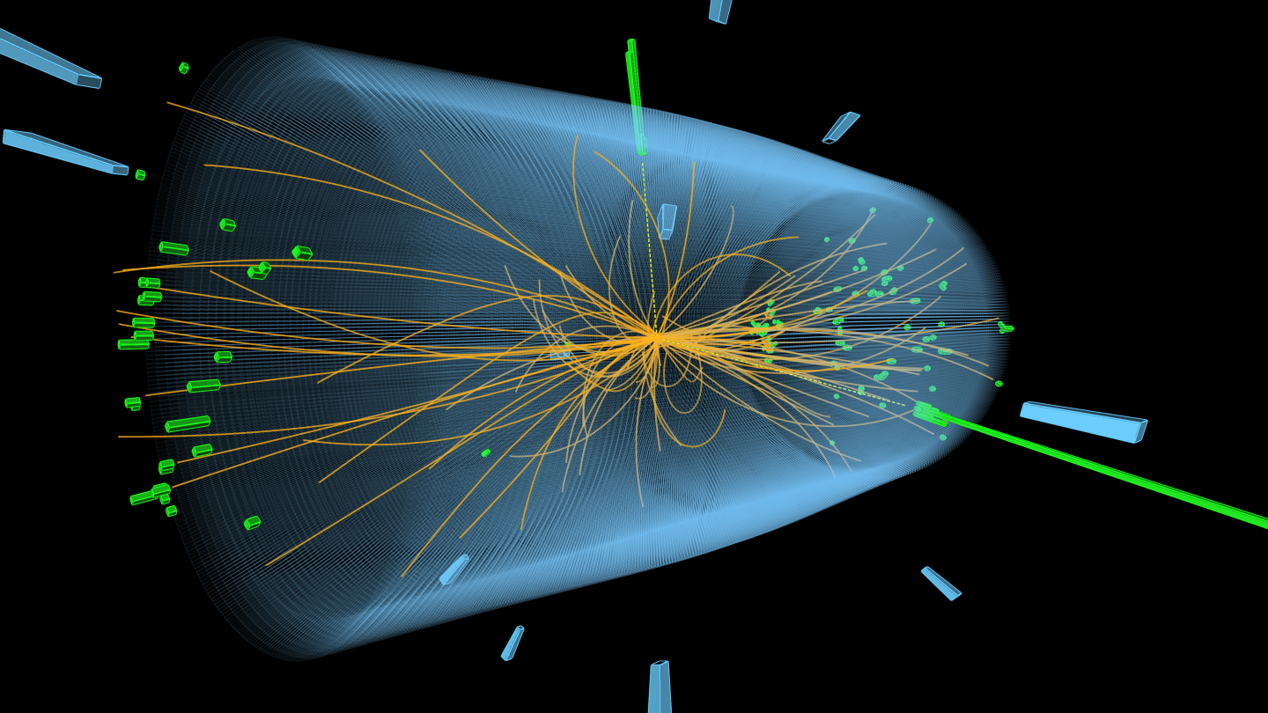
Detector Coordinates

Slide 5
LHC Olympics 2020

Slide 6
R&D Dataset

Slide 7
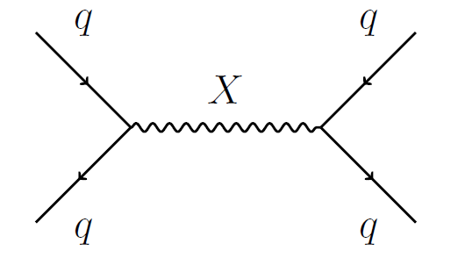
Blackbox 3

Slide 8
Machine learning methods
Unsupervised (GAN, Density estimation, autoencoder, etc.)
Weakly supervised (CWoLa, Tag N’ train)
Semi-supervised

Slide 9
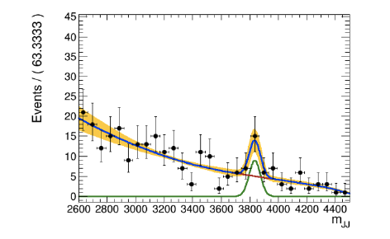
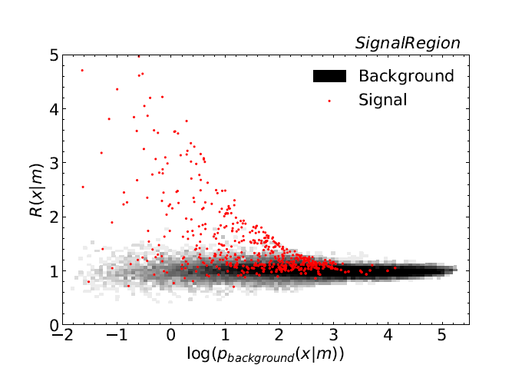
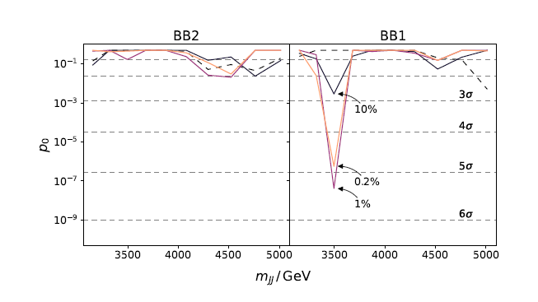
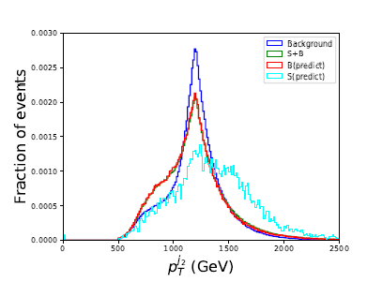

Slide 10
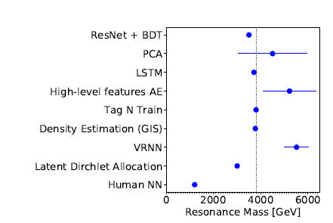
Overall results
Some successful results for Blackbox 1
False positives for Blackbox 2
No successful results for Blackbox 3

Slide 11
Reference
Cern Infographics gallery
The LHC Olympics 2020 (https://arxiv.org/abs/2101.08320)

